Slide 1
Introduction to hand tools
Mr. Warren

Slide 2
Hand tool Safety
Before you use any tool, you should know how it works and some of the possible dangers of using it the wrong way.
Always read and understand the procedures and safety tips in the manufacturer’s guide for every tool you use.
Make sure every tool you use is in good condition.
Never use worn or damaged tools.

Slide 3
Hammers
Hammers are made in different sizes and weights for specific types of work.
The safest hammers are those with heads made of alloy and drop-forged steel.
Two of the most common hammers are the claw hammer and the ball peen hammer.

Slide 4
Claw Hammers

Slide 5
Claw Hammers
The claw hammer has a steel head and a handle made of wood, steel or fiberglass.
You use the head to drive nails, wedges and dowels.
You use the claw to pull nails out of wood.
The face of the hammer may be flat or rounded.

Slide 6
Claw Hammers
It’s easier to drive nails with the flat face claw hammer, but the flat face may leave hammer marks when you drive the head of a nail flush with the surface of the work.
A claw hammer with a slightly rounded face is called a bell-faced hammer.
It can be used to drive a nails flush without damaging the surface of the work.

Slide 7
Ball peen Hammers

Slide 8
Ball peen Hammers
A ball peen hammer is a type of hammer used in metalworking.
It has a flat face for striking and a spherical or hemispherical head for peening (rounding off) metal rivets.
You use this hammer with chisels and punches.
In welding, the ball peen hammer is used to reduce stress on the weld by peening or striking the joint as it cools.

Slide 9
Ball peen Hammers
Ball peen hammers are also known as engineer’s hammers or machinist’s hammers.
They are classified by weight, and can weigh 6 ounces to 2 ½ lbs.
Never use a ball peen hammer to drive in nails, because the head of the hammer is made of tough, but relatively soft steel.

Slide 10
Ball peen Hammers
Continuous pounding on nails can deform or damage the hammer’s head.
A claw hammer is not interchangeable with a ball peen hammer.

Slide 11
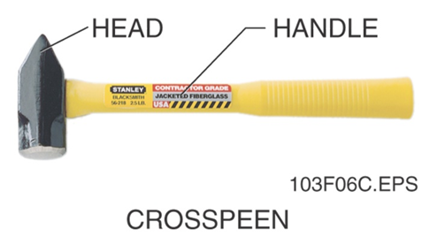
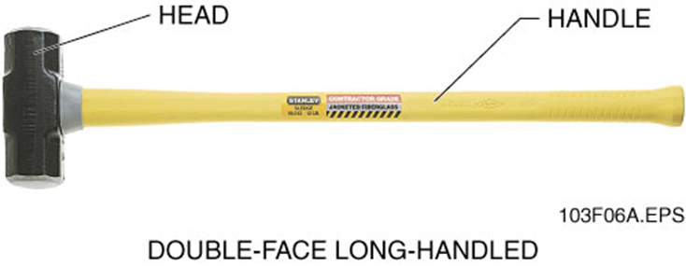
Sledge Hammers

Slide 12
SledgeHammers
A sledgehammer is a heavy-duty tool used to drive posts or other large stakes.
You can also use it to break up cast iron or concrete.
The head of the sledgehammer is made of high-carbon steel and weighs 2 to 20lbs.
Sledgehammers can be either long-handled or short-handled, depending on the jobs they are designed for.

Slide 13
SledgeHammer safety
Wear eye protection when using a sledge hammer. It is also a good idea to wear gloves.
Replace broken or cracked handles before you use the sledgehammer.
Make sure the handle is secured firmly at the head.
Use the right amount of force for the job.

Slide 14
SledgeHammer safety
Keep your hands away from the object you are driving.
Don’t swing until you have checked behind you to make sure you have enough room and no one is behind you.

Slide 15
Ripping bars

Slide 16
Ripping bars
Also called a pinch, pry or wrecking bar.
Can be 12 to 36 inches long.
Used for heavy-duty dismantling of woodwork, such as tearing apart building frames or concrete forms.
Has an octagonal (eight-sided) shaft and two specialized ends.

Slide 17
Ripping bars
A deeply curved nail claw at one end is used as a nail puller.
An angled, wedge-shaped face at the other end is used as a prying tool to pull apart materials that are nailed together.
When using a ripping bar, make sure that you always wear the appropriate PPE and keep balanced footing

Slide 18
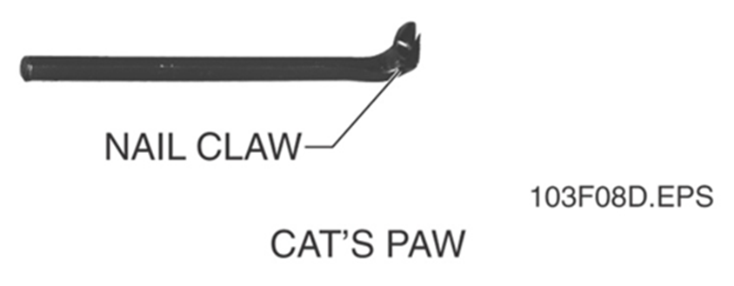
Nail Pullers
Cat’s paw (also called nail claws and carpenters pincers)

Slide 19
Nail Pullers
The cat’s paw is a straight steel rod with a curved claw at one end.
It is used to pull nails that have been driven flush with the surface of the wood or slightly below it.
You use the cat’s paw to pull the nails to just above the surface of the wood so they can be pulled completely out with the claw of a hammer or pry bar.

Slide 20
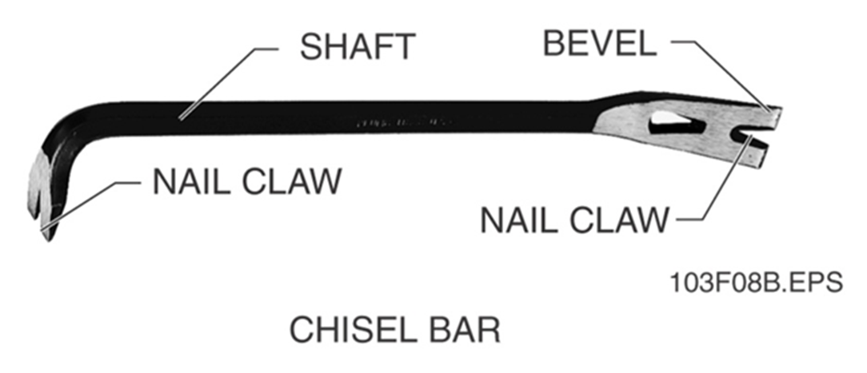
Nail Pullers
Chisel Bar

Slide 21
Nail Pullers
The chisel bar has a claw at each end and is ground to a chisel-like bevel (slant) on both ends.
You can use it like a claw hammer to pull nails.
You can also drive it into wood to split and rip apart the pieces.

Slide 22
Nail Pullers
Flat bar

Slide 23
Nail Pullers
The flat bar has a nail slot at the end to pull nails out from tightly enclosed areas.
It can also be used as a small pry bar.
The flat bar is usually 2 inches wide and 15 inches long.
To prevent injury when pulling a nail, be sure the material holding the nail is braced securely before you pull.

Slide 24
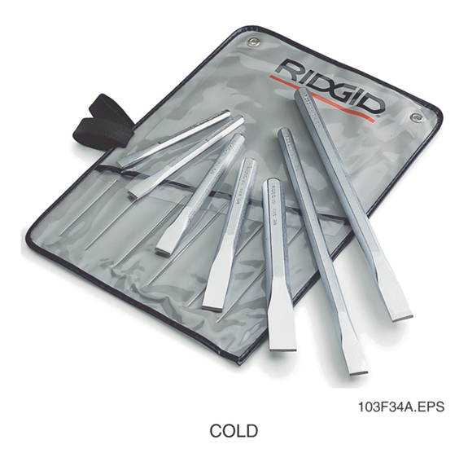
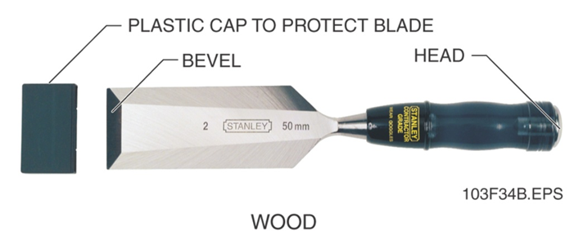
Chisels
You will learn about two kinds of chisels in this section.

Slide 25
Chisels
Chisels are used to cut and shape wood, stone, or metal.
A chisel is a metal tool with a sharpened, beveled (sloped) edge.
Both types are made from steel that is heat-treated to make it harder.
Can cut any material that is softer than the steel of the chisel.

Slide 26
Chisels
Always wear safety goggles
Don’t use a chisel head or hammer that has become mushroomed or flattened.
Sharpen the cutting edge of a chisel on an oil-stone to produce a keen edge.

Slide 27
Punches
A punch used the impact of a hammer to indent metal before you drill a hole, to drive pins, and to align holes in two parts that are mates.
Punches are made of hardened and tempered steel, and come in various sizes.

Slide 28
Punches
The center and prick punches are used to make small locating points for drilling holes.
The straight punch is used to punch holes in thin sheets of metal.

Slide 29
Punches
Three common types of punches are the center punch, the prick punch and the straight punch.
Prick Punch
Tapered Punch

Slide 30
Screwdrivers
A screwdriver is used to tighten or remove screws.
They are identified by the type of screw they fit.
The most common screwdrivers are slotted (flat head) and Phillips head screwdrivers.
You may also use more specialized screwdrivers such as a clutchdrive, Torx®, Robertson®,and Allen head. (hex)
Don’t use screwdrivers near live wires

Slide 31
Screwdrivers

Slide 32
Pliers and Wire Cutters
Pliers are a special type of adjustable wrench.
They are scissor-shaped tools with jaws. The jaws usually have teeth to help grip objects.
You will generally use pliers to hold, cut, and bend wire and soft metals.
Do not use pliers on nuts or bolt heads. They will round off the edges of the head and wrenches will no longer fit properly.

Slide 33
Pliers and Wire Cutters
High quality pliers are made of hardened steel
Pliers come in many different head styles, depending on their use.
They following types of pliers are the most commonly used:

Slide 34
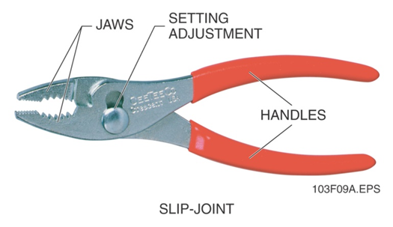
Pliers and Wire Cutters
Slip-joint (combination) pliers

Slide 35
Pliers and Wire Cutters
You use slip-joint pliers to hold and bend wire and to grip and hold objects during assembly operations.
They have adjustable jaws.
There are two jaw settings: one for small materials and one for larger materials.

Slide 36
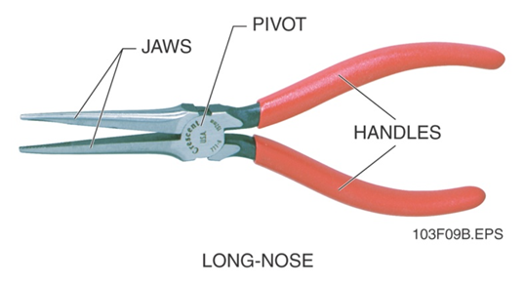
Pliers and Wire Cutters
Long-nose (needle-nose) pliers

Slide 37
Pliers and Wire Cutters
Long-nose pliers are used to get into tight places where other pliers won’t reach, or to grip parts that are too small to hold with your fingers.

Slide 38
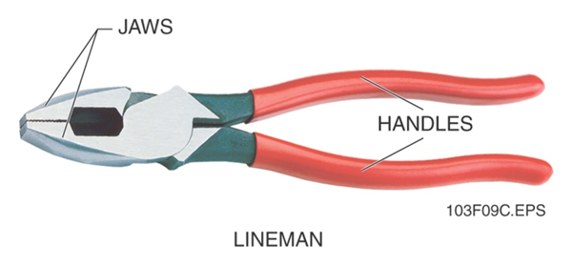
Pliers and Wire Cutters
Lineman pliers (side cutters)

Slide 39
Pliers and Wire Cutters
Lineman pliers have wider jaws than slip-joint pliers do.
You use them to cut heavy or large-gauge wire, and to hold work.
The wedged jaws reduce the chance that wires will slip, and the hook bend in both handles give you a better grip.

Slide 40
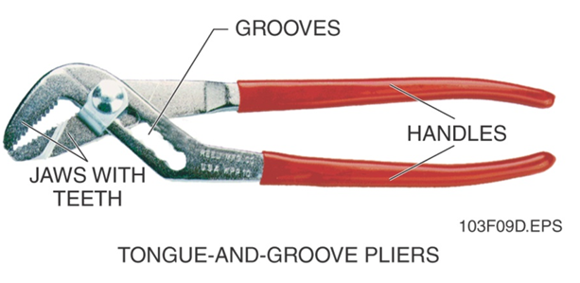
Pliers and Wire Cutters
Tongue-and-groove (CHANNELLOCK®) pliers

Slide 41
Pliers and Wire Cutters
Tongue-and-groove pliers have serrated teeth that grip flat, square, round, or hexagonal objects.
You can set the jaws in any of five positions by slipping the curved ridge into the desired groove.
Large tongue-and-groove pliers are often used to hold pipes, because the longer handles give more leverage.

Slide 42
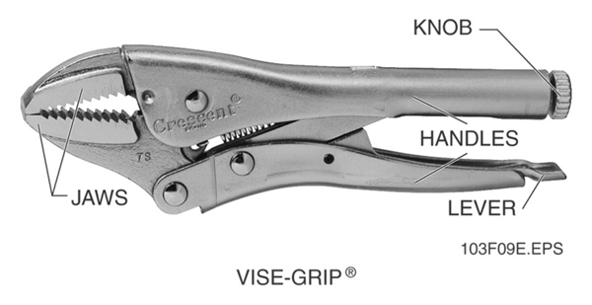
Pliers and Wire Cutters
Locking pliers (Vise-Grip®)

Slide 43
Pliers and Wire Cutters
Locking pliers clamp firmly onto objects the way a vise does
A knob in the handle controls the width and tension of the jaws.
You close the handles the lock the pliers, and release the pliers by pressing the lever to open the jaws.

Slide 44
Wrenches
Wrenches are used to hold and turn screws, nuts, bolts, and pipes.
There are many types of wrenches, but they fall into two main categories: nonadjustable and adjustable.
They come in both standard and metric sizes.
Adjustable wrenches can be expanded to fit different-sized nuts and bolts.

Slide 45
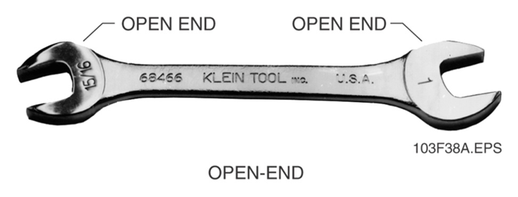
Nonadjustable Wrenches
Open-end wrench

Slide 46
Nonadjustable Wrenches
The open end wrench is one of the easiest non adjustable wrenches to use.
It has an opening at each end that determines the size of the wrench.
Often, one wrench has two different-sized openings, such as 7/16 inch and ½ inch, one on each end.

Slide 47
Nonadjustable Wrenches
The sizes measure the distance between the flats (straight sides or jaws of wrench opening) of the wrench and the distance across the head of the fastener used.

Slide 48
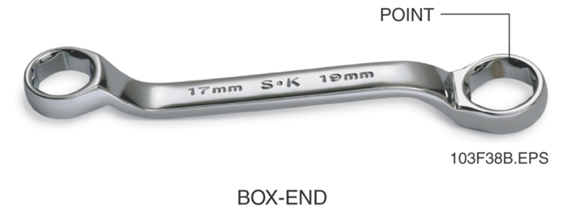
Nonadjustable Wrenches
Box-end wrenches

Slide 49
Nonadjustable Wrenches
Box-end wrenches form a continuous circle around the head of the fastener.
The ends have 6 or 12 points.
The ends come in different sizes ranging from 3/8 inch to 15/16-inch.
Box-end wrenches offer a firmer grip than open-end wrenches.

Slide 50
Nonadjustable Wrenches
Box-end wrenches are safer to use than open end wrenches because they will not slip off the sides on certain kinds of bolts.
The handles of box-end wrenches are available in a range of lengths.

Slide 51
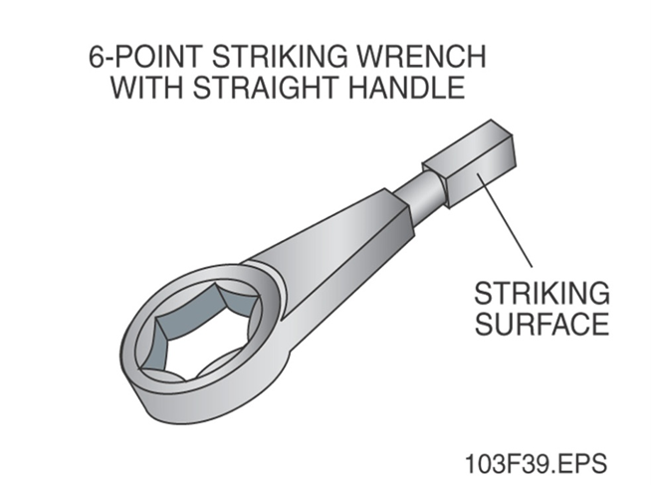
Striking or slugging wrenches

Slide 52
Striking or slugging wrenches
Striking or slugging wrenches are similar to box-end wrenches in that they have an enclosed circular opening designed to lock onto the fastener when the wrench is struck.
The wrenches have a large striking surface so you can hit them more accurately, usually with a mallet or handheld sledge hammer.

Slide 53
Striking or slugging wrenches
Striking wrenches are only used in certain situations, such as when a bolt has become stuck to another material through rust or corrosion.
Striking wrenches can damage screw threads and bolt heads.

Slide 54
Hex key wrenches

Slide 55
Hex key wrenches
Hex key wrenches are L-shaped, hexagonal (six-sided) steel bars.
Both ends fit the socket of a screw or bolt.
The shorter length of the L-shape is called the head, and the shorter length is the handle

Slide 56
Hex key wrenches
You might use them with setscrews.
Setscrews are used in tools and machinery to set two parts tightly together so they don’t move from the set position.

Slide 57
Combination wrenches

Slide 58
Combination wrenches
Combination wrenches are, as the name implies, a combination of two types of wrenches.
One end of a combination wrench is open and the other end is closed, or box-end
They speed up your work because you don’t have to keep changing wrenches.

Slide 59
Combination wrenches
Combination wrenches are, as the name implies, a combination of two types of wrenches.
One end of a combination wrench is open and the other end is closed, or box-end
They speed up your work because you don’t have to keep changing wrenches.

Slide 60
Adjustable wrenches
Adjustable wrenches are used to tighten or remove nuts and bolts and all types of sizes of pipes.
They have one fixed jaw and one movable jaw.
Common types include pipe wrenches, spud wrenches, and adjustable end wrenches.
They save time when working with different sizes of nuts and bolts.

Slide 61
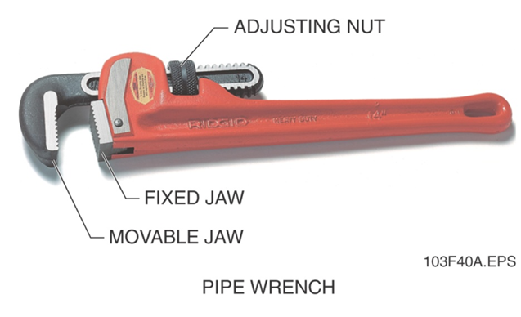
Adjustable wrenches
Pipe wrench

Slide 62
Adjustable wrenches
Pipe wrenches (often called monkey wrenches) are used to tighten and loosen all types and sizes of threaded pipe.
You adjust the upper jaw of the wrench by turning the adjusting nut.
Both jaws have serrated teeth for gripping power.

Slide 63
Adjustable wrenches

Slide 64
Sockets and ratchets

Slide 65
Sockets and Ratchets
Socket wrench sets include different combinations of sockets and ratchets that are used to turn the sockets.
Most sockets have 6 or 12 gripping points.
The end of the socket that fits into the handle is square.
Sockets come in different lengths.

Slide 66
Sockets and Ratchets
The longer socket is called a deep socket.
It is used when normal sockets will not reach down over the end of the bolt and grip it
The ratchet handle has a small lever that you can use to change the turning direction.

Slide 67
Torque wrenches

Slide 68
Torque wrenches
Torque wrenches measure resistance to turning.
You need them when installing fasteners that must be tightened in sequence without distorting the workpiece.
You will use a torque wrench only when a torque setting is specified for a particular bolt.

Slide 69
Torque wrenches
Torque specifications are usually stated in inch-pounds for small fasteners or foot-pounds for large fasteners.
Hold the head of the wrench with one hand to support he bolt and to make sure it is properly aligned

Slide 70
Steel Rule

Slide 71
Steel rule
The flat steel rule is the simplest and most common measuring tool.
Flat steel rules are usually 6 or 12 inches long, but longer sizes are available.
They can be flexible or nonflexible, thin or wide.
The thinner the rule, the more accurately it measures.

Slide 72
Measuring tape

Slide 73
Measuring tape
The standard tape measure blade is marked similarly to a 1/16-inch standard ruler.
Along with the ½ inch, ¼ inch, 1/8 inch, and 1/16 inch markings, the standard tape measure may also include metric increments.
The curve of the tape measure blade is designed to strengthen the blade and makes the tape easier to read when it is placed on a surface to be marked.

Slide 74
Wooden folding rule

Slide 75
Wooden folding rule
A wooden folding rule is usually marked in sixteenths of an inch on both edges of each side.
Folding rules come in 6 and 8 foot lengths.
Because of its stiffness, a folding rule is better for measuring vertical distance.
Unlike a tape measure it can be held straight up.

Slide 76
Laser measuring tools

Slide 77
Laser measuring tools
A laser measuring tool can be considered a battery powered, electronic version of a tape measure.
They work by pointing it at a specific object and then pressing a measurement button on the control panel.
When the button is pressed, a laser shoots out at the object and a reading is sent back.

Slide 78
Levels

Slide 79
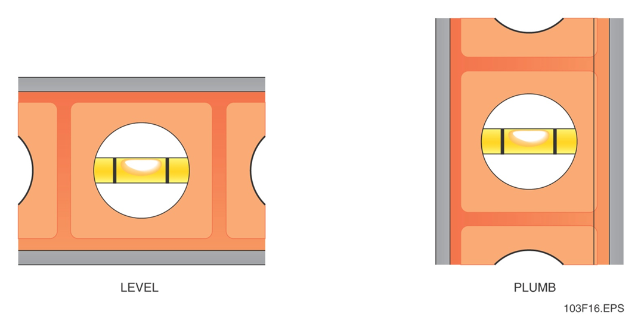
Levels
A level is a tool used to determine both how level a horizontal surface is and how plumb a vertical surface is.

Slide 80
Carpenter’s Square

Slide 81
Carpenter’s Square
The carpenter’s square (framing square) is shaped like an L and is used mainly for squaring up sections of work such as wall studs and sole plates.
The carpenter’s square has a 24-inch blade and a 16-inch tongue, forming a right (90 degree) angle.

Slide 82
Speed Square

Slide 83
Speed Square
The speed square is another type of carpenter's square, frequently made of cast aluminum.
It is a combination protractor, try square, and framing square.
It is marked with degree gradations for fast, easy layout.

Slide 84
Try Square

Slide 85
try Square
The try square is a fixed, 90-degree angle and is used mainly for woodworking.
You can use it to lay out cutting lines at 90-degree angles, to check the squareness of adjoining surfaces, to check a joint to make sure it is square, and to check if a planed piece of lumber is warped or cupped.

Slide 86
Combination Square

Slide 87
Combination Square
The combination square has a ruled blade that moves through a head.
The head is marked with 45 degree and 90 degree angle measures.
The combination square is one of the most useful tools for layout work.

Slide 88
Plumb bob

Slide 89
Plumb bob
The plumb bob is a pointed weight attached to a string, uses the force of gravity to make the line hang vertical, or plumb.
When the weight is allowed to hang freely, the string is plumb.
A plumb bob can also show what point on the floor is directly under the section of the beam you need to support.

Slide 90
Plumb bob
The plumb bob is a pointed weight attached to a string, uses the force of gravity to make the line hang vertical, or plumb.
When the weight is allowed to hang freely, the string is plumb.
A plumb bob can also show what point on the floor is directly under the section of the beam you need to support.

Slide 91
Chalk lines

Slide 92
Chalk lines
A chalk line is a piece of string or cord that is coated with chalk.
You stretch the line tightly between two points and then snap it to release a chalky line to the surface.

Slide 93
Utility knives

Slide 94
Utility knives
A utility knife is used for variety of purposes including cutting roofing felt, fiberglass or asphalt shingles, vinyl or linoleum floor tiles, fiberboard, and gypsum board.
You can also use it for trimming insulation.
The utility knife has a replaceable razor-like blade.

Slide 95
Utility knives
It has a handle about six inches long, made of cast-iron or plastic, to hold the blade.
The handle is made of two halves, held together with a screw.
Models that have a retractable blade are the safest.
Place some scrap under the object you are cutting. This will protect the surface under the object.

Slide 96
Backsaws

Slide 97
Backsaws
The standard blade of this saw is 8 to 14 inches long with 11 to 14 tpi (teeth per inch)
A backsaw has a broad, flat blade and a reinforced back edge.
Its is used for cutting joints, especially miter joints and tenons.

Slide 98
Compass keyhole saw

Slide 99
Compass keyhole saw
The standard blade of the saw is 12 to 14 inches long with 7 or 8 tpi.
This saw curves quickly in wood, plywood, or wallboard.
It is also used to cut holes for large-diameter pipes, vents, and plugs or switch boxes.

Slide 100
Coping saw

Slide 101
Coping saw
This saw has a narrow, flexible 6 ¾-inch blade attached to a U-shaped frame.
Holders at each end of the frame can be rotated so you can cut angles.
Standard blades range from 10-20 tpi.
The coping saw is used for making irregular-shaped moldings fit together cleanly.

Slide 102
Drywall saw

Slide 103
Drywall saw
A drywall saw is a long, narrow saw used to cut softer building materials, such as drywall.
The blade on a drywall saw has a very sharp point, so that you can easily poke a hole to start your cut without drilling a starter hole.

Slide 104
hacksaw

Slide 105
hacksaw
The standard blade of this saw is 8 to 16 inches with 14 to 32 tpi.
It has a sturdy frame and a pistol-grip handle.
The blade is tightened using a wing nut and bolt.
Hacksaws are used to cut through metal, such as nails, bolts, or pipe.

Slide 106
hacksaw
When installing a hacksaw blade, be sure that the teeth face away from, not toward the saw handle.
Hacksaws are designed to cut on the push stroke, not on the pull stroke.
Brace yourself when sawing so you are not thrown off balance on the last stroke.

Slide 107
handsaw

Slide 108
handsaw
The standard blade of this saw is 26 inches long with 8 to 14 tpi for a crosscut saw and 5 to 9 tpi for a ripsaw.
The crosscut saw is designed to cut across the grain (the direction of the fibers) of wood.
The ripsaw is designed to cut with the grain(parallel to the wood fibers) of wood.

Slide 109
Files and rasps

Slide 110
Rasp-cut file
The teeth are individually cut; they are not connected to each other.
They give a very rough surface.
Used mostly on aluminum lead, and other soft metals to remove waste materials.
Also used on wood.

Slide 111
Single-cut file
Has a single set of straight-edged teeth running across the file at an angle.
Used to sharpen edges, such as rotary mower blades.
After using any file, brush away any filing with a file card

Slide 112
double-cut file
Two sets of teeth crisscross each other.
Types are bastard(roughest cut), second cut, and smooth cut.
They are used for fast cutting.

Slide 113
C-clamps

Slide 114
C-clamps
This multipurpose clamp has a C-shaped frame.
The clamp has a metal shoe at the end of a screw.
Using a T-bar, you tighten the clamp so that it holds material between the metal jaw of the frame and the shoe.

Slide 115
Locking C-clamp

Slide 116
Locking C-clamp
This clamp works like locking pliers.
A knob in the handle controls the width and tension of the jaws.
You close the handles to lock the clamp and release the clamp by pressing the lever to open the jaws.

Slide 117
Spring clamp

Slide 118
Spring clamp
You use your hand to open the spring-operated clamp.
When you release the handles, the spring holds the clamp tightly shut, applying even pressure to the material.
The jaws are usually made of steel, some with plastic coating to protect the material’s surface against scarring.

Slide 119
bar clamp

Slide 120
Bar clamp
A rectangular piece of steel or aluminum is the spine of the bar clamp.
It has a fixed jaw at one end and a sliding jaw (tail side) with a spring-locking device that moves along the bar.

Slide 121
Pipe clamps

Slide 122
Pipe clamp
Although this clamp looks like a bar clamp, the spine is actually a length of pipe.
It has a fixed jaw and a movable jaw that work the same way as the bar clamp.
The movable jaw has a lever mechanism that you squeeze when sliding the movable jaw along the spine.

Slide 123
Hand- screw clamp

Slide 124
Hand- screw clamp
This clamp has wooden jaws.
It can spread pressure over a wider area than other clamps can.
Each jaw works independently.
You can angle the jaws toward or away from each other or keep them parallel.

Slide 125
web clamp

Slide 126
web clamp
This clamp uses a belt-like canvas or nylon strap or band to apply even pressure around a piece of material.
After looping the band around your work, you use the clamp head to secure the band.
A quick-release device loosens the band after you are finished.

Slide 127
Clamps safety and maintenance
Clean and oil threads
Discard clamps with bent frames
Don’t use clamp for hoisting(pulling up) work .

Slide 128
Chain falls

Slide 129
Chain falls
The chain fall has an automatic brake that holds the load after it is lifted.
As the load is lifted, a screw forces fiber discs together to keep the load from slipping.
The brake pressure increases as the loads get heavier. The brake holds the load until the lowering chain is pulled. Do not get lubricant on the clutches.

Slide 130
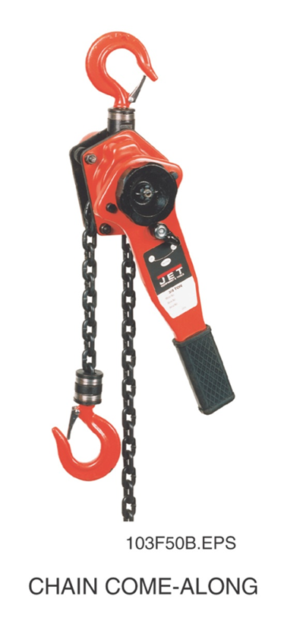
Come-alongs

Slide 131
Come-alongs
Come-alongs, also called cable pullers, use a ratchet handle to position loads or to move heavy loads horizontally over short distances.
They can support loads from 1 to 6 tons.
Some come-alongs use a chain for moving their loads; others use wire ropes.

Slide 132
Come-alongs
When using a chain come-along, use the ratchet handle to take up the chain and the ratchet release to allow the chain to be pulled out.
You can also use the fast-wind handle to take up or let out slack in the chain without using the ratchet handle.
Do not get lubricant on the clutches.

Slide 133
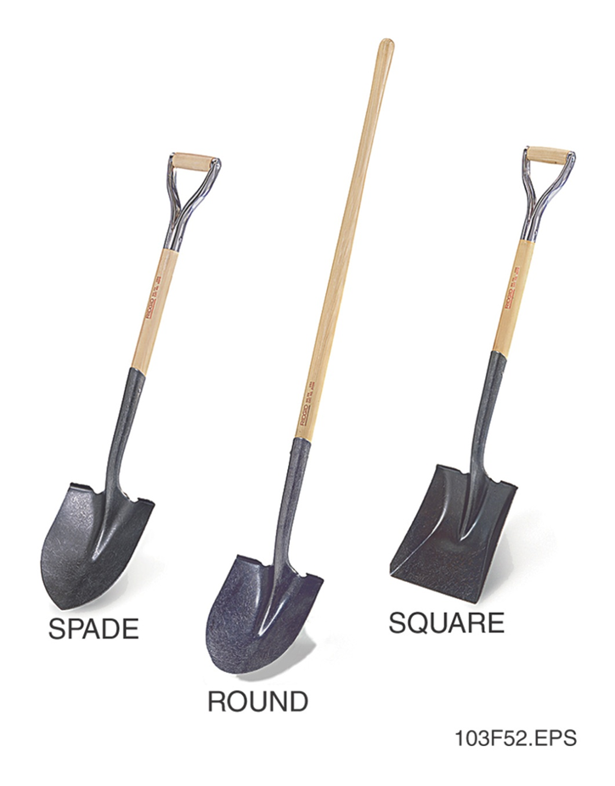
shovels

Slide 134
shovels
Shovels are used by many different construction trades.
An electrician running underground wiring may dig a trench.
A concrete mason may dig footers for a foundation.
A carpenter may clear dirt from an area for concrete form building.

Slide 135
shovels
A plumber may dig a ditch to lay pipe.
A welder may use a shovel to clean up scrap metal and slag after the job is finished.
There are three basic shapes of shovel blades: round, square, and spade

Slide 136
shovels
Use a round bladed shovel to dig holes or remove large amounts of soil.
Use a square bladed shovel to move gravel or clean up construction debris.
Use a spade to move large amounts of soil or dig trenches that need smooth, straight sides.

Slide 137
picks

Slide 138
picks
A pick is a swing tool similar to an ax.
A pick consists of a wooden handle that is 36 to 45 inches in length, and a forged steel head that can weigh between 2 and 3 pounds.
Depending on the size and strength of the pick, it can be used to break hardened or rocky soil, to level out stones and pavers, to chop tree roots and loosen soil, and to break up stones and concrete.

Slide 139
Picks
Always check to ensure that the head is fixed firmly to the handle.
Be sure to wear appropriate eye protection
Always use a pick that is of the appropriate length and weight for your size.

