Slide 1
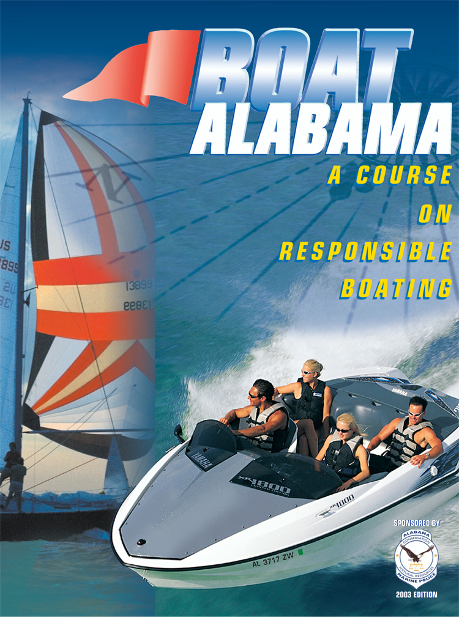

Slide 2
Lesson Four: Legal Requirements Who May Operate A Vessel
Robertson/Archer Act of 1994 requires every person who operates a motorized vessel (including Personal Water Craft (PWC)) on Alabama waters must first obtain a boater safety certification(Vessel License). Does not apply to operators of sailboats, rowboats or canoes.

Slide 3
Lesson Four: Legal Requirements Who May Operate A Vessel (cont.)
Boater Safety Certification Requirements for Alabama Residents
If you are under 12 years of age as of January 1, 2002: may obtain boater safety certification after you turn 12 but may operate a vessel only if person 21 or more with a valid certification is onboard and in position to take immediate physical control of the vessel
After you turn 14 you may legally operate vessel without supervision

Slide 4
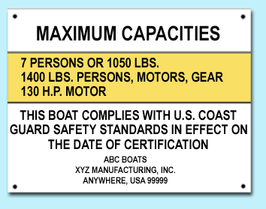
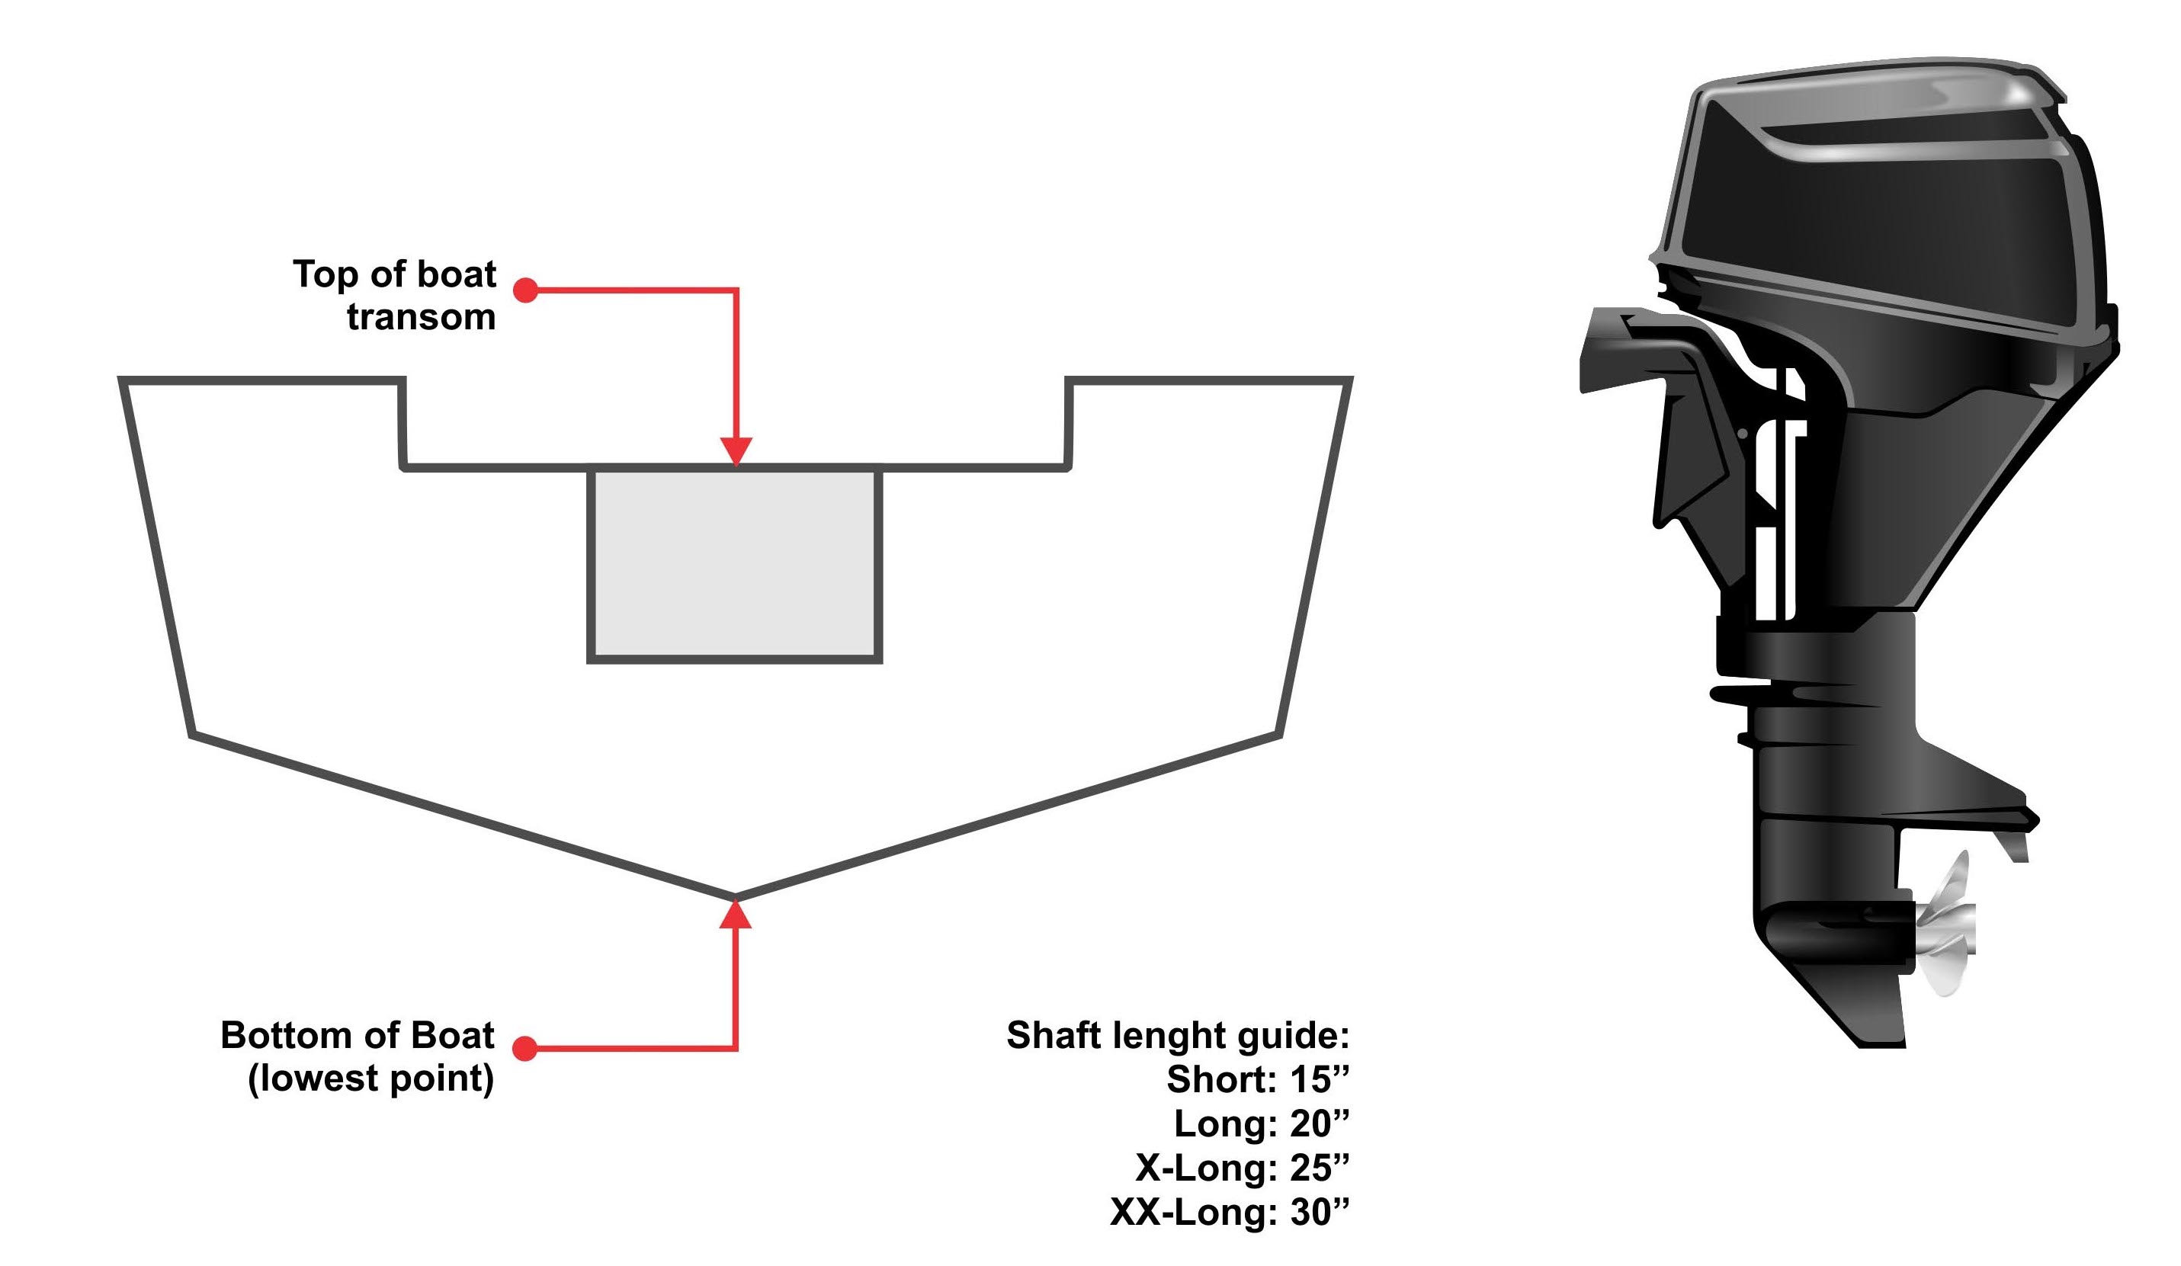
Lesson Two: Before You Get Underway Capacity
Never take a vessel on the water with too many people or too much gear onboard. Vessels loaded beyond capacity will more easily swamp or capsize
Capacity plate is located near the operator’s position or on the transom.

Slide 5
Lesson Six: Enjoying Water Sports Responsibilities
Operators are responsible for ensuring that their passengers understand basic safety practices and laws:
Use a pre-departure checklist to ensure you’ve taken necessary safety precautions then discuss with your passengers

Slide 6
Lesson Four: Legal Requirements Visual Distress Signals
Visual Distress Signals (VDSs) allow vessel operators to signal for help in the event of an emergency
VDSs must be in serviceable condition, readily accessible and certified as complying with USCG requirements
VDSs are classified as: VDSs are either:
Day signals (visible in bright sunlight) Pyrotechnic (smoke and flames)
Night signals (visible at night) Non-pyrotechnic (non-combustible)
Both day and night signals

Slide 7
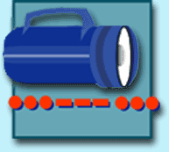
Lesson Four: Legal Requirements Visual Distress Signals (cont.)
Pyrotechnic Visual Distress Signals
Orange Smoke Red Meteor Red Flare
Day Signal Day and Night Signal Day and Night Signal
Non-Pyrotechnic Visual Distress Signals
Electric Light Orange Flag Night Signal Day Signal

Slide 8
Lesson Three: Operating Your Boat Safely! Docking
Docking basics:
Approach into wind if possible and move slowly
Bring vessel to stop by using reverse gear
Never try to stop with your arms or legs

Slide 9
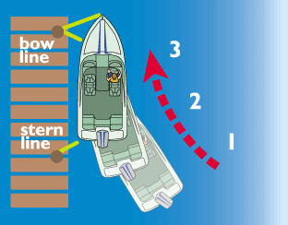
Lesson Three: Operating Your Boat Safely! Docking (cont.)
If there is no wind or current:
Approach dock at a narrow angle (10° to 20°)
When close enough, secure bow line
Swing stern in, secure it, then shut off engine

Slide 10
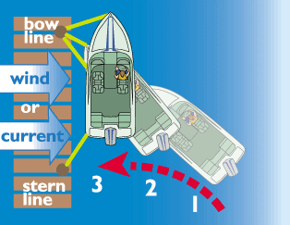
Lesson Three: Operating Your Boat Safely! Docking (cont.)
If wind or current is pushing you away from dock:
Point bow toward dock at 40° to 50° angle; approach dock and secure bow line
Use reverse to swing in stern
Secure stern line

Slide 11
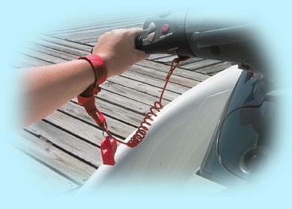
Lesson Three: Operating Your Boat Safely! Ignition Safety Switches
Emergency ignition safety switch has lanyard which attaches operator to switch
If lanyard is removed from switch, the engine will shut off

Slide 12
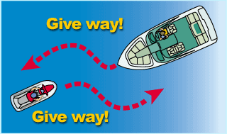
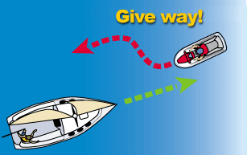
Lesson Three: Operating Your Boat Safely! Navigation Rules (cont.)
When meeting another vessel head-on:
Power vs. Power : Neither vessel is stand-on boat -- both vessels should keep to starboard (right)
Power vs. Sail: Powerboat is give-way boat

Slide 13
Lesson Five: Boating Emergencies Boating Accidents (cont.)
If someone falls overboard, immediately:
Reduce speed and throw victim a PFD
Turn vessel around and carefully pull alongside victim
Stop the engine. Pull victim onboard over the stern keeping weight in the vessel balanced

Slide 14
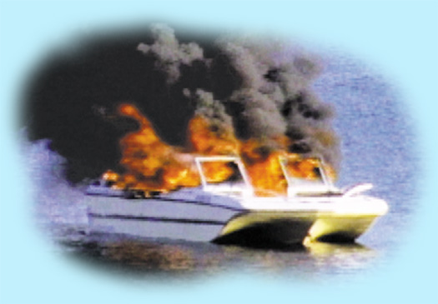
Lesson Four: Legal Requirements Backfire Flame Arrestors
All powerboats (except outboards) fueled with gasoline must have an approved backfire flame arrestor on each carburetor
Backfire flame arrestors are designed to prevent ignition of gasoline vapors in case of engine backfire

Slide 16
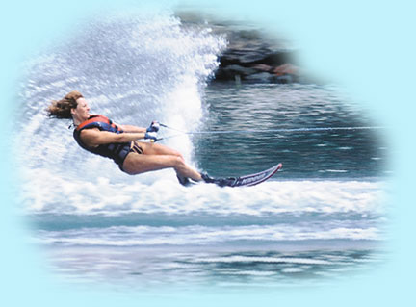
Lesson Six: Enjoying Water Sports Water skiing
Before towing a water skier vessel operator should:
Have second person onboard to act as observer
Review hand signals with skier for proper communication
Make sure skier is wearing USGC approved PFD
Be familiar with skiing area and any water hazards

Slide 17
Lesson Four: Legal Requirements Sound Producing Devices
Sound producing device is necessary in periods of reduced visibility or whenever vessel operator needs to signal intentions or position
On Alabama state waters, requirements for sound producing devices are:
Vessels less than 16 ft. not required but strongly recommended they carry horn or whistle
Vessels 16 ft. to 26 ft. required to carry a whistle or horn or some other means to make efficient sound signal audible for at least on-half mile
Vessels 26 ft. to 40 ft. required to carry whistle or horn or some other means to make efficient sound signal audible for at least one mile

Slide 18
Lesson Three: Operating Your Boat Safely! Sound Signals
Sound signals are composed of short and long blasts:
Short blast is about one second in duration
Prolonged blast is 4-6 seconds in duration

Slide 19
Lesson Three: Operating Your Boat Safely! Sound Signals (cont.)
Vessel operators use sound signals to communicate change in direction to other boaters:
One short blast (TOOT) tells other boaters “I intend to turn to my right”
Two short blasts (TOOT TOOT) tells other boaters “I intend to turn to my left”
Three short blasts tells other boaters “I am backing up”

Slide 20
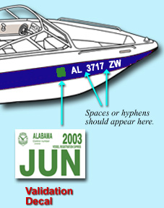
Lesson Four: Legal Requirements Registration and Decals (cont.)
Display number and decals as follows:
Number must be painted, decaled or otherwise affixed to both sides of bow
Number must read from left to right on both sides of bow
Number must be at least 3 inches high in BLOCK letters

Slide 21
Lesson Four: Legal Requirements Personal Flotation Devices (cont.)
Each PFD must be:
In good condition
Proper size for the intended wearer (based upon body weight and chest size)
Readily available
Vessel operators should ask everyone to wear PFD

Slide 22
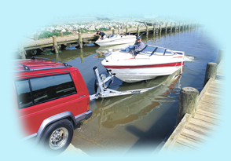
Lesson Two: Before You Get Underway Trailering Your Vessel
Have the right trailer for your vessel:
Width and length of vessel determine width and length of trailer
Weight of vessel, engine and gear should not exceed 90% of trailer’s recommended load capacity

Slide 23
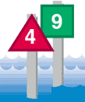
Lesson Three: Operating Your Boat Safely! U. S. Aids To Navigation System (ATON)
U. S. Aids to Navigation System uses nuns, cans, and daymarks as lateral navigation markers:
Nuns and Cans – red triangular-shaped (nuns) or green cylindrical-shaped (cans)
Lighted Buoys – marked with Lateral System
Daymarks – red triangles or green squares attached permanently to structures; can be lighted

Slide 24
Lesson Three: Operating Your Boat Safely! U. S. Aids To Navigation System (cont.)
Lateral Markers
Colors and numbers mean the same thing regardless of kind of buoy or marker:
Red colors, red lights, and even numbers indicate right side of channel as boater enters from open sea or heads upstream
Green colors, green lights and odd numbers indicate left side of channel as boater enters from open sea or heads upstream

Slide 25
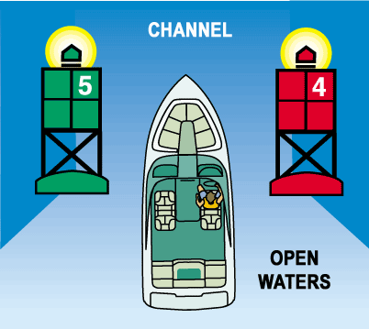
Lesson Three: Operating Your Boat Safely! U. S. Aids To Navigation System (cont.)
Use this phrase as a reminder of the correct course when returning from open waters or heading upstream:
“Red Right Returning”

Slide 26
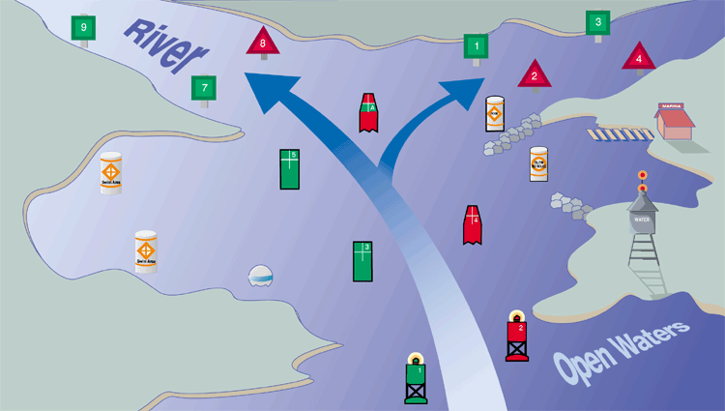
Lesson Three: Operating Your Boat Safely! Compasses and Charts (cont.)

Slide 27
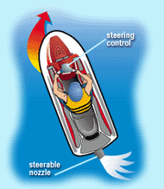
Lesson Three: Operating Your Boat Safely! Personal Watercraft (PWC)
Steering and stopping a PWC:
PWC are steered by water being forced through steering nozzle at back of unit
Remember you must always have power in order to maintain steering control
Always allow plenty of room for stopping

Slide 28
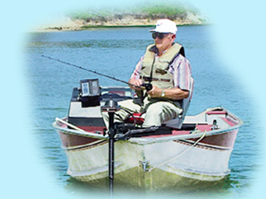
Lesson Six: Enjoying Water Sports Fishing
Anglers using a vessel to fish should:
Know and follow all safe boating laws and requirements
Pay attention to capacity plate and don’t overload vessel
Wear PFD especially when the water is cold or when fishing alone or in remote areas
Recycle or toss used fishing line into receptacles onshore and not into waters or onto shorelines

Slide 29
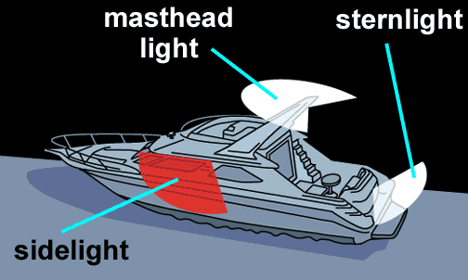
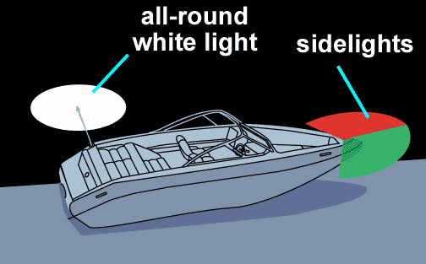
Lesson Three: Operating Your Boat Safely! Navigation Lights (cont.)
Sidelights – red and green lights (also called combination lights) visible from side or head-on
red light indicates vessel’s port (left) side
green light indicates vessel’s starboard (right) side

Slide 30
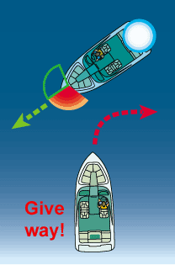
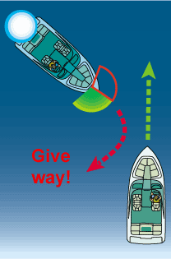
Lesson Three: Operating Your Boat Safely! Night Navigation (cont.)
When you see red and white lights you must give-way to other vessel
When you see white and green lights you are the stand-on boat; but, stay alert

Slide 31
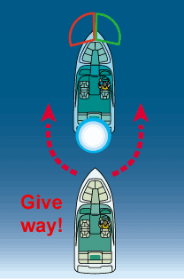
Lesson Three: Operating Your Boat Safely! Night Navigation (cont.)
When you see only a white light, you are overtaking another vessel or it is anchored and it is the stand-on boat

Slide 32
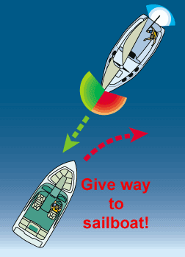
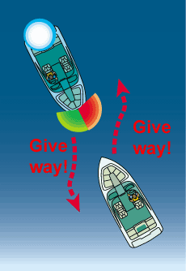
Lesson Three: Operating Your Boat Safely! Night Navigation (cont.)
When you see red, green and white lights, you are approaching another powerboat head-on and so both boats must give-way
When you see only red and green lights, you are approaching sailboat under sail head-on and you must give-way

Slide 33
Lesson Four: Legal Requirements PFD Requirements
All vessels must carry one Type I, II, III or V USCG-approved PFD for each person onboard or being towed. If Type V is used, must be approved for activity at hand
Vessels 16 ft. or longer must also have one Type IV USCG-approved PFD onboard
Each person onboard PWC must wear a properly secured USCG-approved PFD
Each person being towed behind a vessel must wear a properly secured USCG-approved PFD
Children under 8 must wear a properly secured USCG-approved PFD at all times while onboard any vessel, except when in an enclosed cabin

Slide 34
Lesson Four: Legal Requirements Personal Flotation Devices (PFDs)
All vessels must be equipped with USCG-approved life jackets called personal flotation devices (PFDs)
Quantity and type depends on:
Length of vessel
Number of people onboard and/or being towed

Slide 35
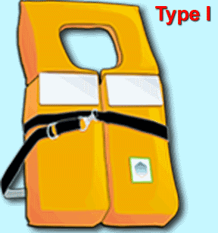
Lesson Four: Legal Requirements Personal Flotation Devices (cont.)
Type I: Offshore Life Jackets
For rough or remote waters where rescue may take awhile
Excellent for flotation -- will turn most unconscious persons face up in water

Slide 36
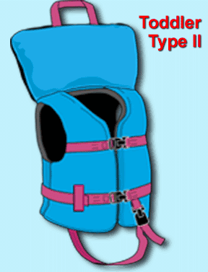
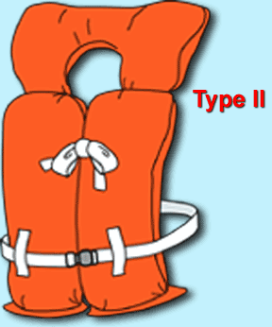
Lesson Four: Legal Requirements Personal Flotation Devices (cont.)
Type II: Near-Shore Vests
Good for calm waters and fast rescues
May lack capacity to turn unconscious wearers face up

Slide 37
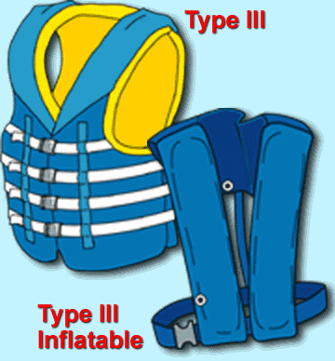
Lesson Four: Legal Requirements Personal Flotation Devices (cont.)
Type III: Flotation Aids
Good for calm waters and fast rescues
Will not turn a person face up
Some designed to inflate when you enter water

Slide 38
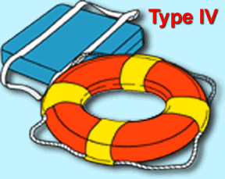
Lesson Four: Legal Requirements Personal Flotation Devices (cont.)
Type IV: Throwable Devices
Cushions or ring buoys designed to be thrown to someone in trouble
Not for long hours in rough waters, non-swimmers or the unconscious

Slide 39
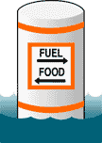
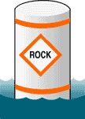
Lesson Three: Operating Your Boat Safely! U. S. Aids To Navigation System (cont.)
Non-Lateral Markers Most common are regulatory markers which use orange markings and black lettering, found on lakes and rivers:
Squares provide information indicating directions, distances, places, food and supplies, repairs, etc.
Diamonds warn of dangers such as rocks, dams, shoals, construction or stumps

Slide 40
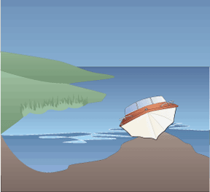
Lesson Five: Boating Emergencies Boating Accidents (cont.)
Knowing your boating environment
Become familiar with locations of shallow water and submerged objects before you go out
Learn to read chart to determine your position and depth
Stop the engine and lift outdrive
Shift weight in the vessel to the area furthest away from the point of impact

Slide 41
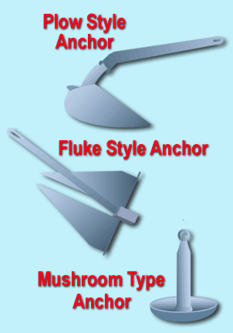
Lesson Three: Operating Your Boat Safely! Anchoring
Most commonly used anchors are:
Plow style anchor good for most vessels; holds by digging itself into bottom sediments
Fluke style anchor (Danforth®) similar to plow style, but more lightweight
Mushroom anchor shouldn’t be used to anchor vessel larger than small canoe, rowboat, sailboat or inflatable since it has little holding power; never use to hold vessel in rough water or weather

Slide 42
Lesson Three: Operating Your Boat Safely! Anchoring (cont.)
Follow these guidelines when anchoring your vessel:
Attach 7-8 feet of galvanized chain to anchor to help prevent abrasion of anchor line from sand or rock on bottom
Select area of little or no current, protected from weather
Lower anchor over the bow to bottom, then slowly back away downwind or down current
Never anchor from stern as this can make vessel unstable

Slide 43
Lesson Four: Legal Requirements Other Equipment and Regulations
Diver Down Flag Federal and state law requires scuba divers and snorkelers display diver down flag to mark diving area. Alabama law requires vessel operators stay at least 100 ft. from displayed flag.
A rectangular red flag, at least 12 x 12 inches, with a white diagonal stripe used to indicate presence of submerged diver in the area. Alabama law requires divers prominently display this flag and stay within 50 ft. radius of the flag

Slide 44
Lesson Five: Boating Emergencies Boating Accidents (cont.)
If vessel sinks or floats away, don’t panic
If you are wearing a PFD, make sure it is securely fastened, remain calm, and wait for help
If you aren’t wearing a PFD, look for one floating in the water or other buoyant items to use as a flotation device
Make sure others are wearing PFDs or have a buoyant item
If there is no other means of support, you may have to tread water or simply float
In cold water, float rather than tread to reduce hypothermia

