Slide 1
Intro to Power Tools

Slide 2
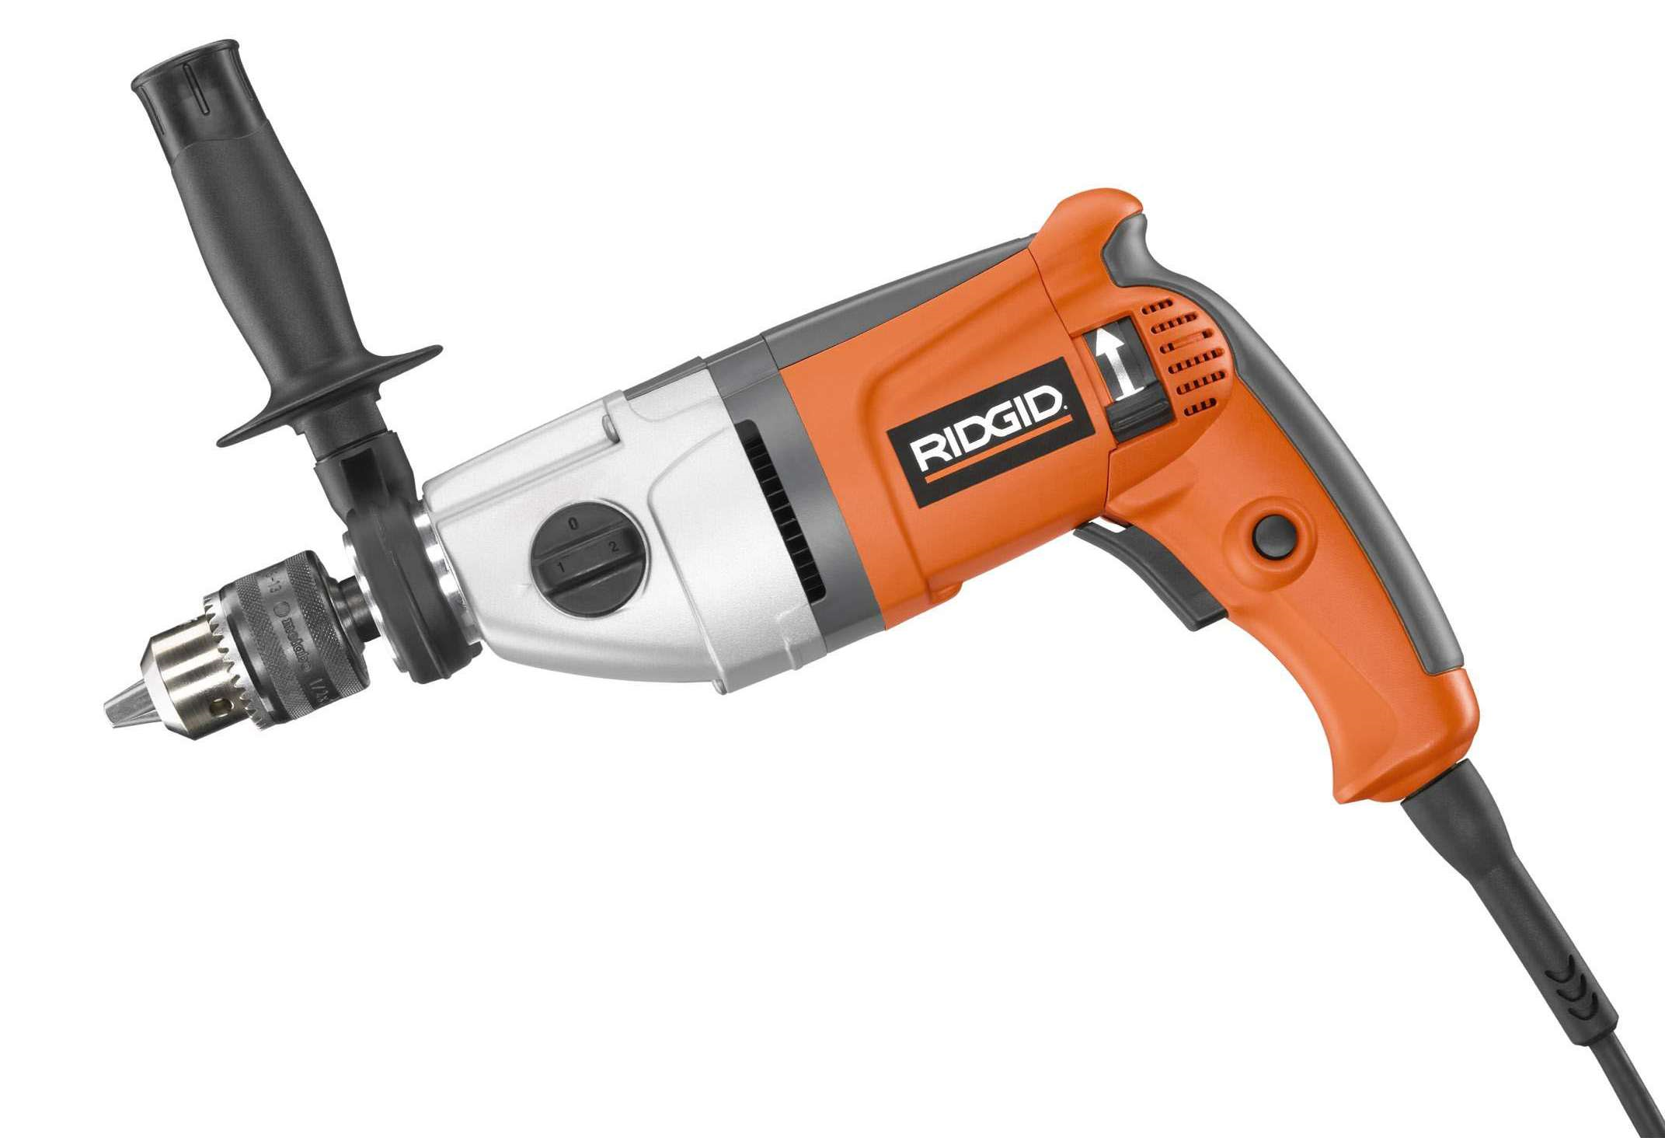
Electric Tools
Tools powered by electricity
Operate on either alternating current (AC) source ( such as a wall receptacle) or a direct current (DC) source (such as a battery)

Slide 3
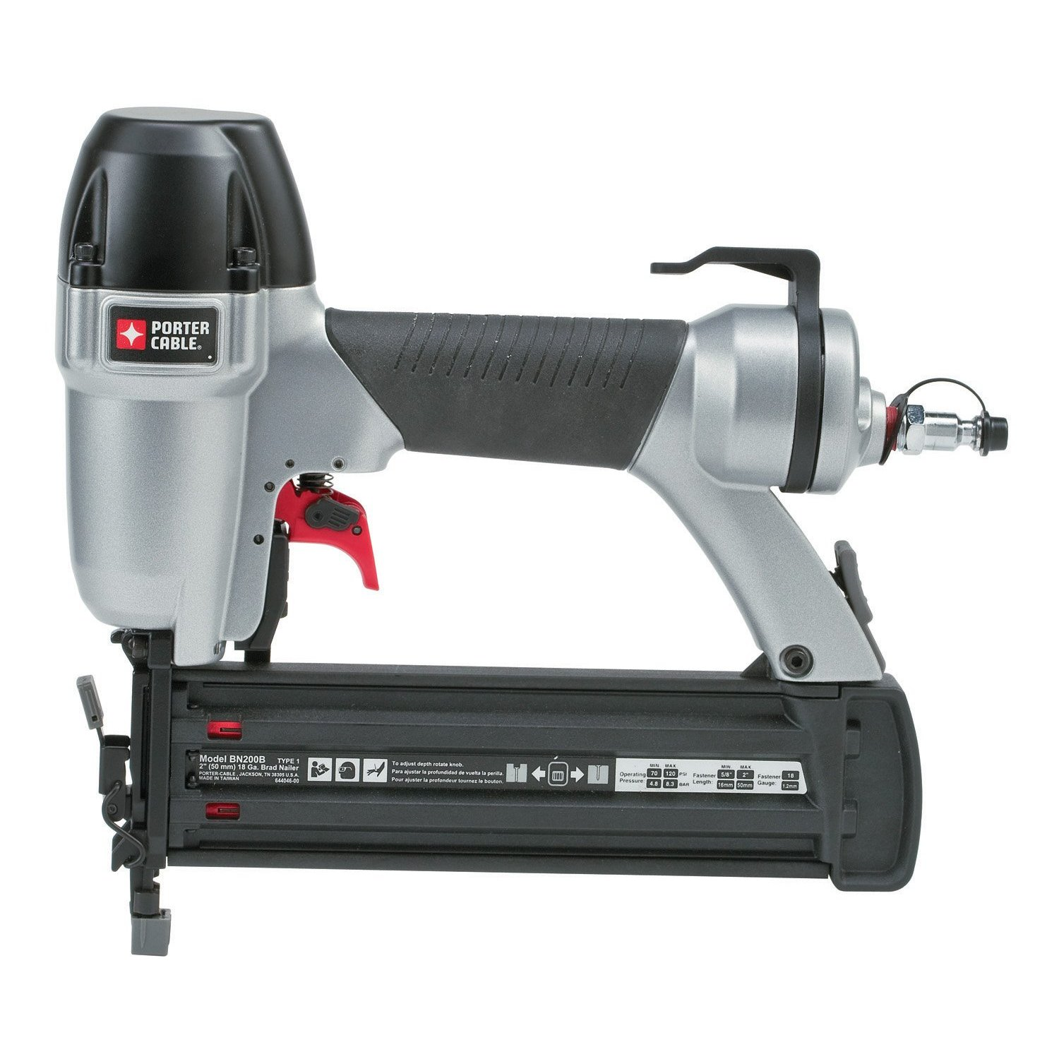
Pneumatic Tools
Tools powered by air.
Electric or gasoline air compressors produce air pressure.
Air hammers and pneumatic nailer are examples of pneumatic tools.

Slide 4
Pneumatic Tools
If the nailer is not firing, disconnect the air hose before you attempt repairs.
Read the manufacturer’s instructions before using a pneumatically powered nailer.

Slide 5
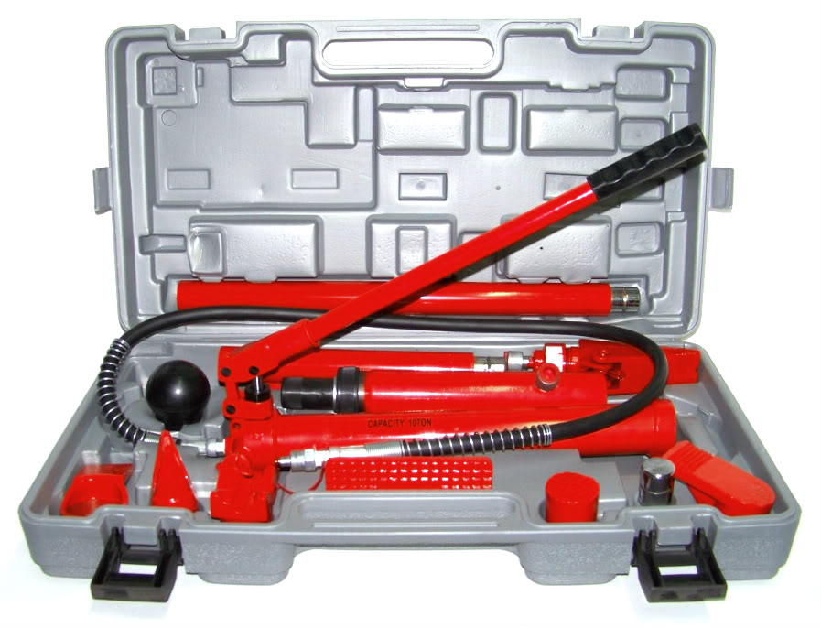
Hydraulic Tools
Tools powered by fluid pressure.
Hand pumps or electric pumps are used to produce the fluid pressure.
Pipe benders, jackhammers, and Porta-Powers® are examples of hydraulic tools.

Slide 6
Power Drills
Most commonly used to make holes by spinning drill bits into wood, metal, plastic and other materials.
With different accessories the power drill can be used as a sander, polisher, screwdriver, grinder or countersink. It can also be used as a saw.

Slide 7
Types Power Drills
Electric drills
Cordless drills
Hammer drills
Electromagnet drills
Pneumatic drills (air hammers)
Electric screwdrivers

Slide 8
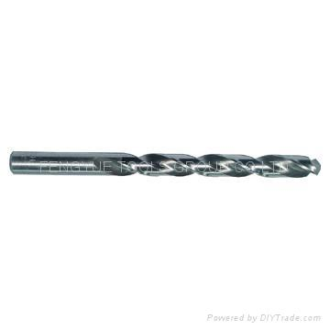
Drill Bits
Twist drill bits are used to drill wood and plastics at high speeds or to drill metal at a lower speed.

Slide 9
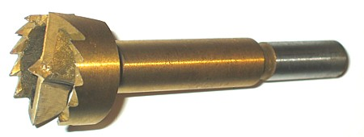
Drill Bits
A forstner bit is used on wood and is good for boring a flat bottom hole.

Slide 10
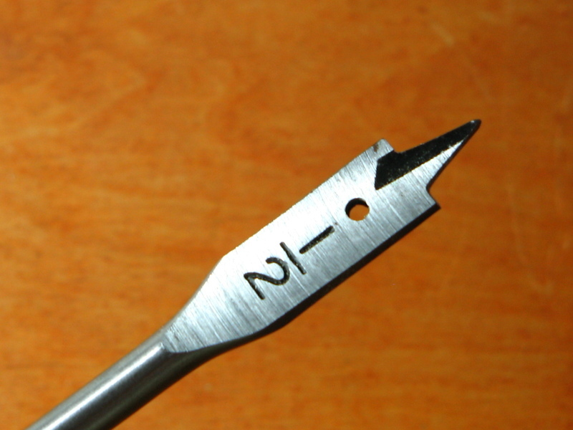
Paddle or Spade Bits
A paddle bit or spade bit is also used for wood.
The bit size is measured by the paddle’s diameter, which generally ranges from ½ inch to 1 ½ inch.

Slide 11
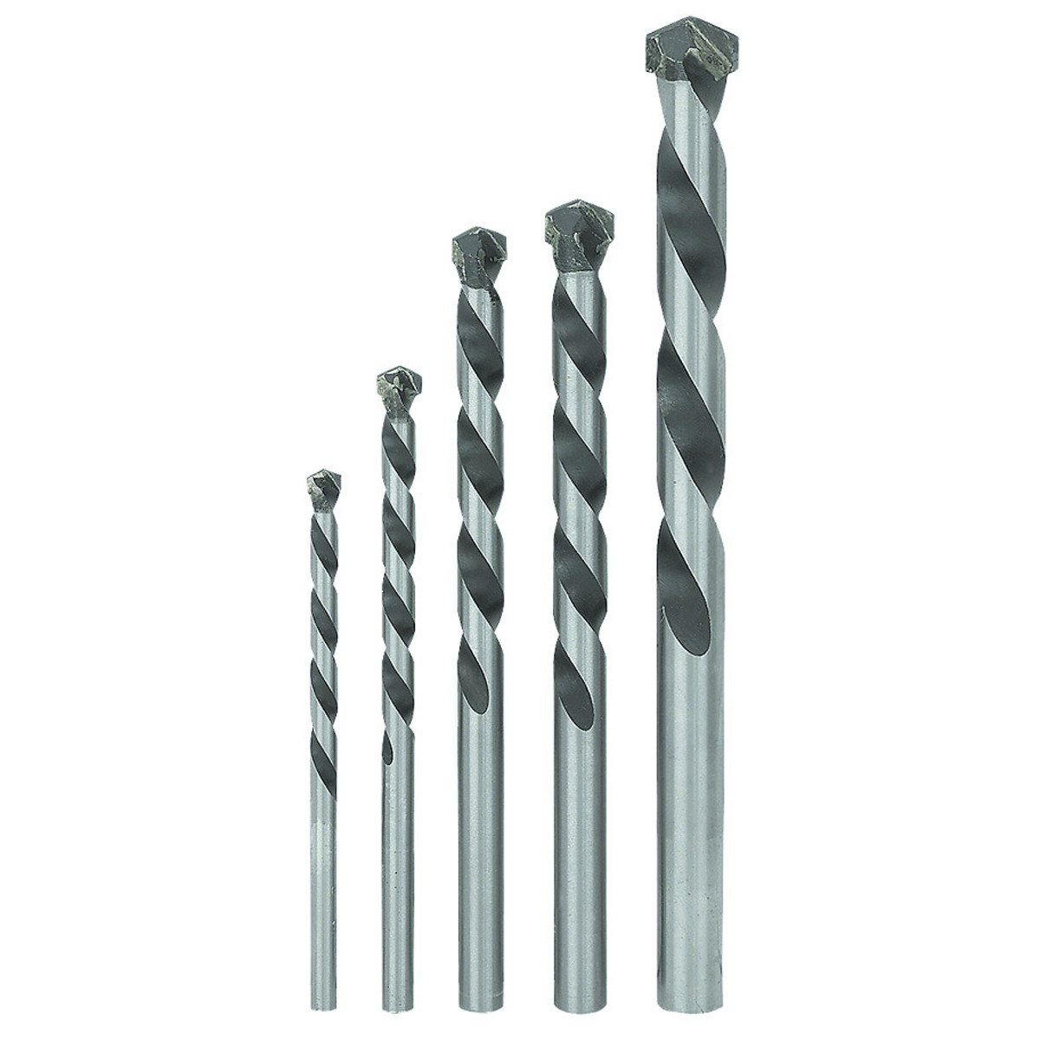
Masonry Bits
A masonry bit, which has a carbide tip, is used in concrete, stone, slate and ceramic.

Slide 12
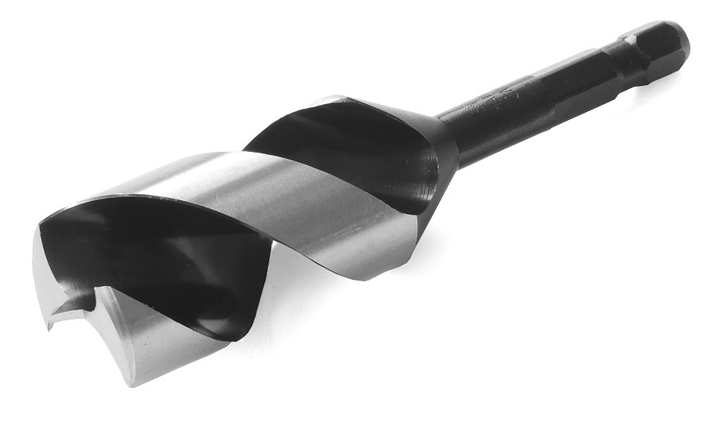
Auger Bits
The auger drill bit is used for drilling wood and other soft materials, but not for drilling metal.
As a rule the point of a bit should be sharper for softer materials than harder ones.

Slide 13
Power Tool Safety
Always wear appropriate personal protective equipment, especially safety glasses.
Keep your hands away from the drill bit and chuck.
To prevent an electrical shock, operate only those tools that are double-insulated electric power tools with proper GFCI.

Slide 14
Power Tool Safety
Before you connect to a power source, make sure the trigger is not turned on.
Always disconnect the power source before you change bits or work on the drill.
Find out what is inside the wall or on the other side of the work material before you cut through a wall partition. Avoid hitting water lines or electrical wiring.

Slide 15
Power Tool Safety
Ensure that tools with two-prong plugs are double insulated. If a tool is not double insulated, its plug must have a third prong to provide grounding.
Use the right bit for the job.
Always use a sharp bit.
Make sure the drill bit is tightened with the chuck before you start the drill.

Slide 16
Power Tool Safety
Hold the drill with both hands, when appropriate, and apply steady pressure. Let the drill do the work.
Never use the trigger lock.
Drills do not need much maintenance, but they should be kept clean.
Keep the drill’s air vent clean with a small brush or small stick. Airflow is crucial to the maintenance and safety of the drill.

Slide 17
Power Tool Safety
Attach the chuck key to the power cord when you are not using the key, so it does not get lost.
Do not overreach when using a power drill.

Slide 18
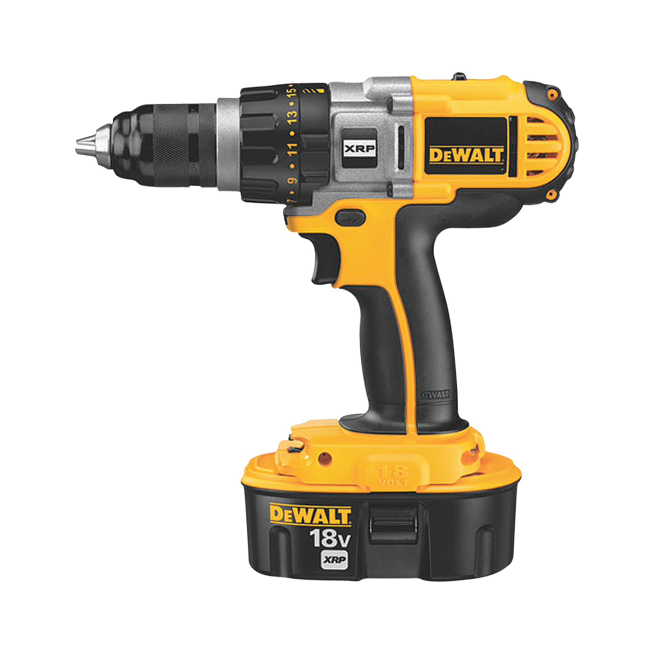
Cordless Drills
Cordless drills contain a rechargeable battery pack that runs the motor.
The pack can be detached and plugged into a battery charger anytime you are not using the drill.

Slide 19
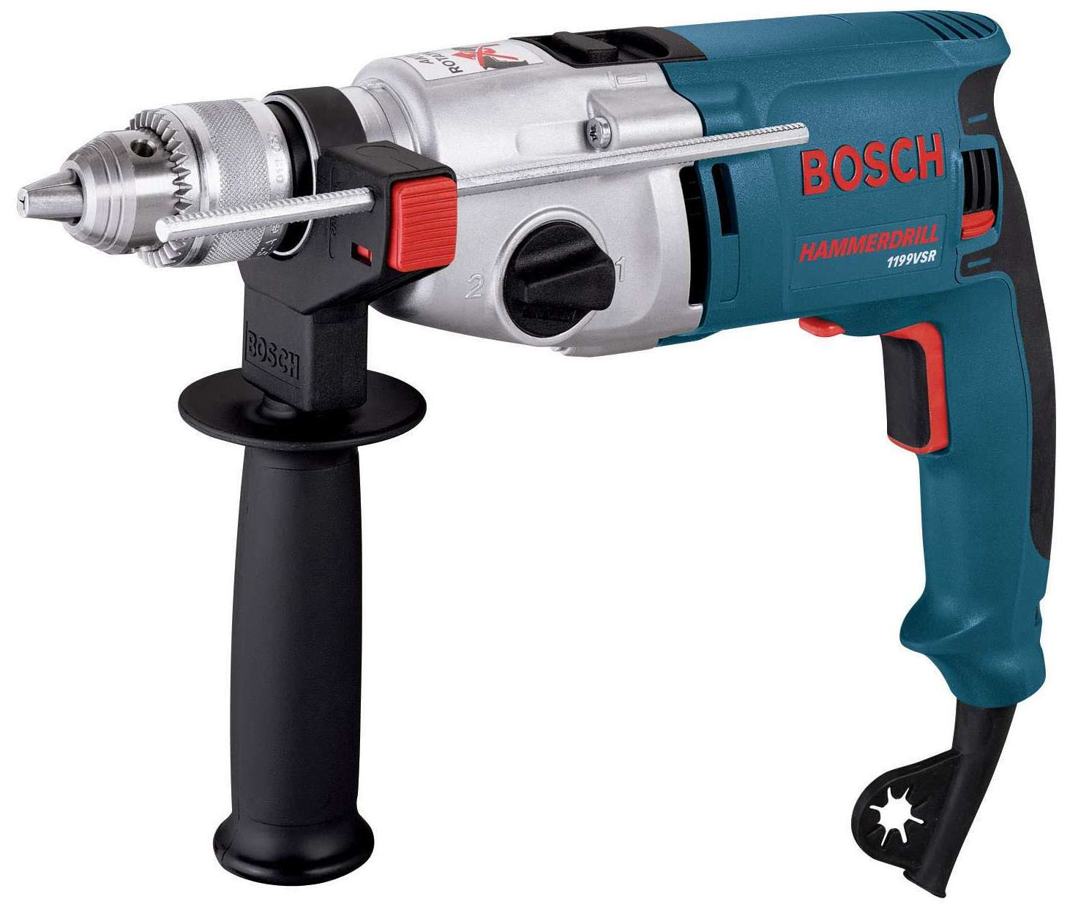
Hammer Drills
The hammer drill has a pounding action that lets you drill into concrete, brick, or tile.
The bit rotates and hammers at the same time, allowing you to drill much faster than you would with a regular drill.

Slide 20
Hammer Drills
The depth gauge on a hammer drill can be set to the depth of the hole that you want to drill.
Most hammer drills will not hammer until you put pressure on the drill bit.
You can adjust the drill’s blows per minute by turning the adjustable ring.
The hammer action stops when you stop applying pressure to the drill.

Slide 21
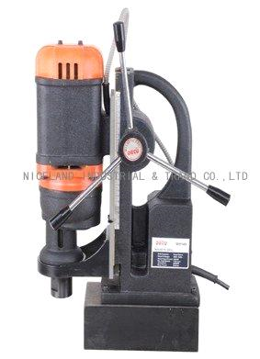
Electromagnetic Drills (drill press)
A portable drill mounted on an electromagnetic base.
Used for drilling thick metal.
When the drill is placed on metal and the power is turned on, the magnetic base will hold the drill in place for drilling.
You can also set the depth gauge to the depth of the hole that you are drilling.

Slide 22
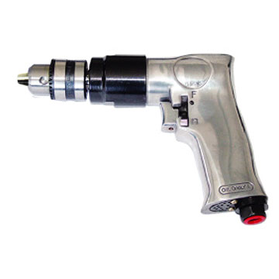
Pneumatic Drills
Pneumatic drills are powered by compressed air from an air hose.
Has many of the same parts, controls and uses as electric drills.
Typically used when there is no source of electricity.

Slide 23
What kind of saw is this?

Slide 24
Circular Saws
Introduced many years ago by a company named Skil®
Also called utility saw, electric handsaw and builder’s saw.
Used to cut lumber and boards to size for a project.
Saw size is measured by the diameter of the circular blade.
7 ¼ inch is the most popular.

Slide 25
Circular Saws
Blade is protective by two blade guards.
Upper guard protect you from flies debris and from touching the spinning blade
Lower guard it retracts up and under the top guard to allow the saw to cut.

Slide 26
Circular Saw Safety
Wear PPE
Ensure that blade is tight.
Check that blade guard is working correctly before you connect the saw to the power source.
Before you cut through a wall, find out what is on the other side. Avoid cutting water lines or electrical wiring.
Keep both hands on the saw grips when possible while operating the saw.

Slide 27
Circular Saw Safety
Never force the saw through the work. This causes binding and overheating and may cause injury.
Never reach underneath the work while you are operating the saw.
Never stand directly behind the work. Always stand to the side of it.
Do not use your hands to hold small pieces of material to be cut. Use a clamp instead.

Slide 28
Circular Saw Safety
Always know where your power cord is located. You don’t want to cut through the power cord by accident and electrocute yourself!
The most important maintenance of a circular saw is at the lower blade guard. Sawdust builds up and causes the guard to stick. If the guard sticks and does not move quickly over the blade after it makes a cut, the bare blade may still be turning when you set the saw down and may cause damage.

Slide 29
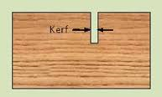
Cutting
Most circular saw blades have a kerf (a cut or channel) 1/8-inch thick. Be sure to cut on the waste side of the material, or your finished piece will be 1/8-inch short.

Slide 30
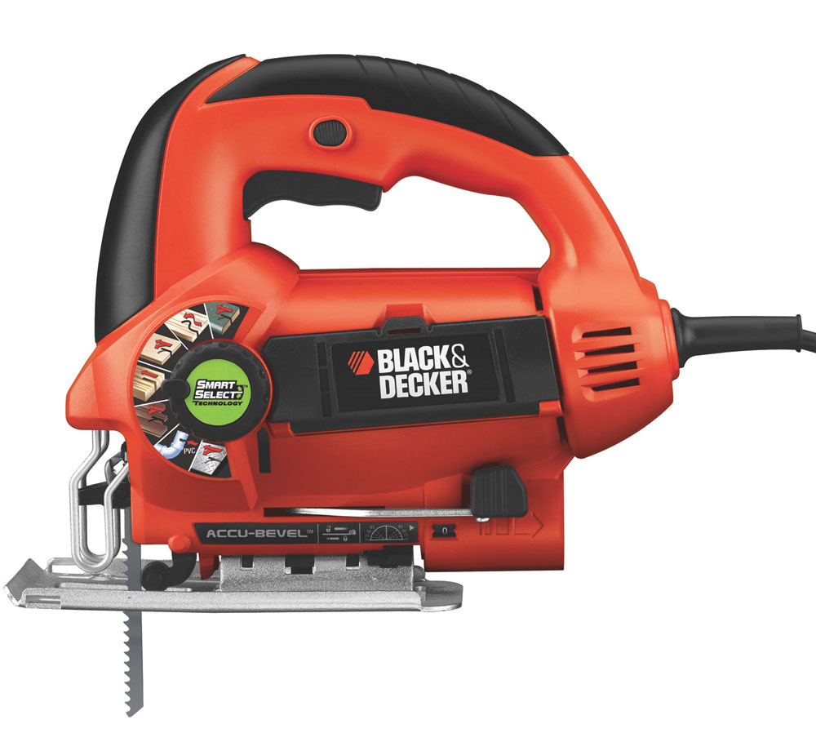
Saber Saws (Jig Saws)
Saber saws are sometimes referred to as jig saws.
Used for cutting out patterns or irregular shapes from wood or thin, soft metals.
Can make straight or curved cuts.
They are also some of the best tools for cutting circles.

Slide 31
Saber Saws (Jig Saws)
Have very fine blades which makes the saw an effective tool for doing delicate and intricate work
They also some of the best tools for cutting circles.

Slide 32
Name That Tool

Slide 33
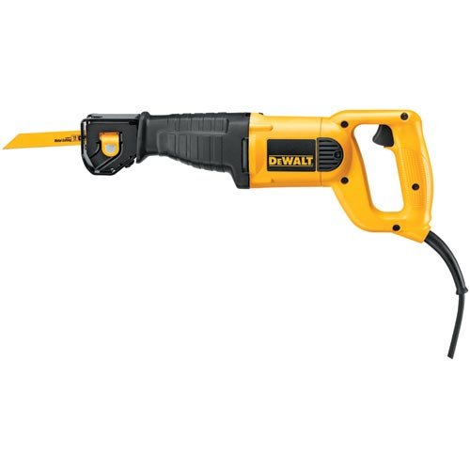
Reciprocating Saws
Regardless of manufactures is often called a SawZall®
Can make both straight and curved cuts.
Used to cut irregular shapes and holes in plaster, plasterboard, plywood, studs, metal and most other materials that can be cut with a saw.

Slide 34
Reciprocating Saws
Blade moves back and forth and is designed for more heavy duty jobs than the saber saw.
Basic tool for any demolition work.

Slide 35
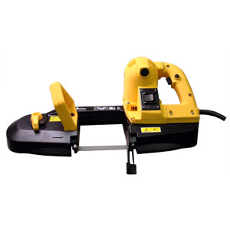
Portable Handheld Bandsaw
Used when its better to move the saw to the work than to move the work to the saw.
The bandsaw can cut pipe, metal, plastics, wood, and irregularly shaped materials.
Good for cutting heavy metal, but will also do fine cutting work.

Slide 36
Portable Handheld Bandsaw
The bandsaw has a one-piece blade that runs in one direction around guides at either end of the saw.
The blade is a thin, flat piece of steel.
The saw often works at various speeds.

Slide 37
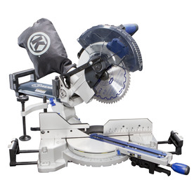
Power Miter Saws
Combines a miter box with a circular saw, allowing it to make straight and miter cuts.
There are two types of power miter boxes: Power miter saws and compound miter saws.

Slide 38
Power Miter Saw
In a power miter saw the blade pivots horizontally from the rear of the table and locks in position to cut angles from 0 degrees to 45 degrees right to left.
The blade of a compound miter saw can be tilted vertically, allowing the saw to be used to make a compound cut (combined bevel and miter cut)

Slide 39
Compound Miter Saw

Slide 40
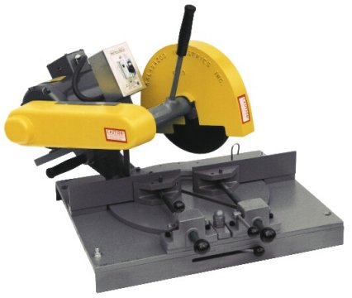
Abrasive Cutoff Saw
Also referred to as a chop saw or a cutoff saw
Used to make straight cuts through thicker materials such as angle iron, flat bar, and channel.

Slide 41
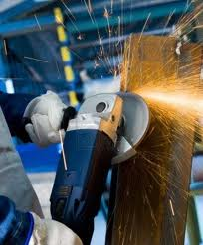
Angle Grinders, End Grinders and Detail Grinders
Angle grinders: Used to grind away hard, heavy materials and used to grind surfaces such as pipes, plates, or welds.

Slide 42
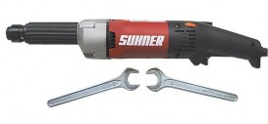
Angle Grinders, End Grinders and Detail Grinders
End grinders: Used to smooth the inside of materials such a pipe.
Also called horizontal grinders or pencil grinders.

Slide 43
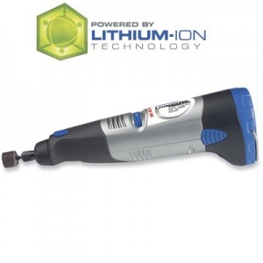
Angle Grinders, End Grinders and Detail Grinders
Detail grinders: Use small attachments, also called points, to smooth and polish intricate metallic work.

Slide 44
Bench Grinders

Slide 45
Bench Grinders
Electrically powered stationary grinding machines.
Usually have two grinding wheels that are used for grinding, rust removal, and metal buffing.
Also great for renewing worn edges and sharpening cutting tools
Always adjust the tool rest so they are within 1/8 inch of the wheel.

Slide 46
Pneumatically Powered Nailers

Slide 47
Pneumatically Powered Nailers
Also referred to as “nail guns”
They greatly speed up the installation of materials such as wallboard, molding, framing members, and shingles.
Keep the nailer oiled by adding a few drops of oil to the air inlet before each use.
The nails come in coils and in strips and are loaded into the nail gun.

Slide 48
Powder- Actuated Fastening Systems

Slide 49
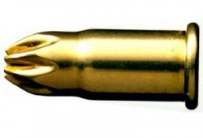
Powder- Actuated Fastening Systems
A low velocity fastening system powered by gunpowder cartridges called boosters.
Used for anchoring static loads to steel and concrete beams, walls, and so forth.
Used to drive steel pins or threaded studs directly into masonry and steel.

Slide 50
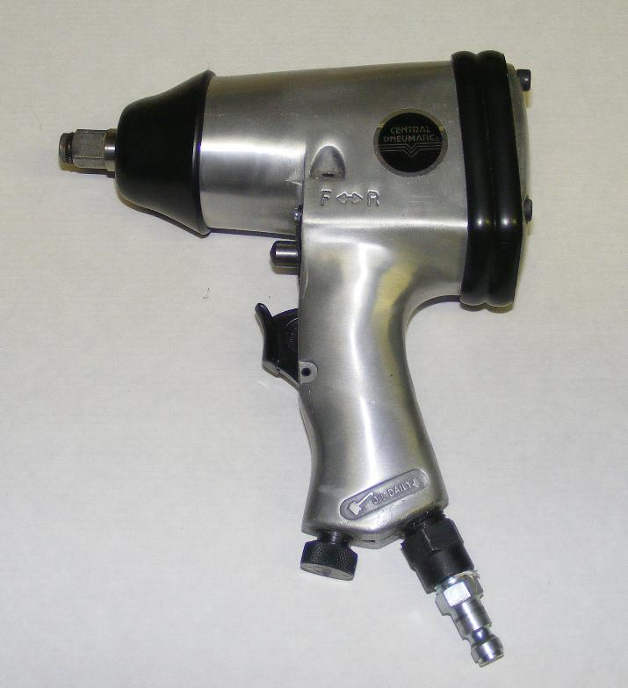
Air Impact Wrench
Power tools that are used to fasten, tighten, and loosen nuts and bolts.
The speed and strength (torque) of these wrenches can be easily adjusted depending on the type of job.

Slide 51
Air Impact Wrench
Air impact wrenches are powered pneumatically (with compressed air)
In order to operate an air wrench, it must be attached with a hose to an air compressor.
Keep your body stance balanced

Slide 52
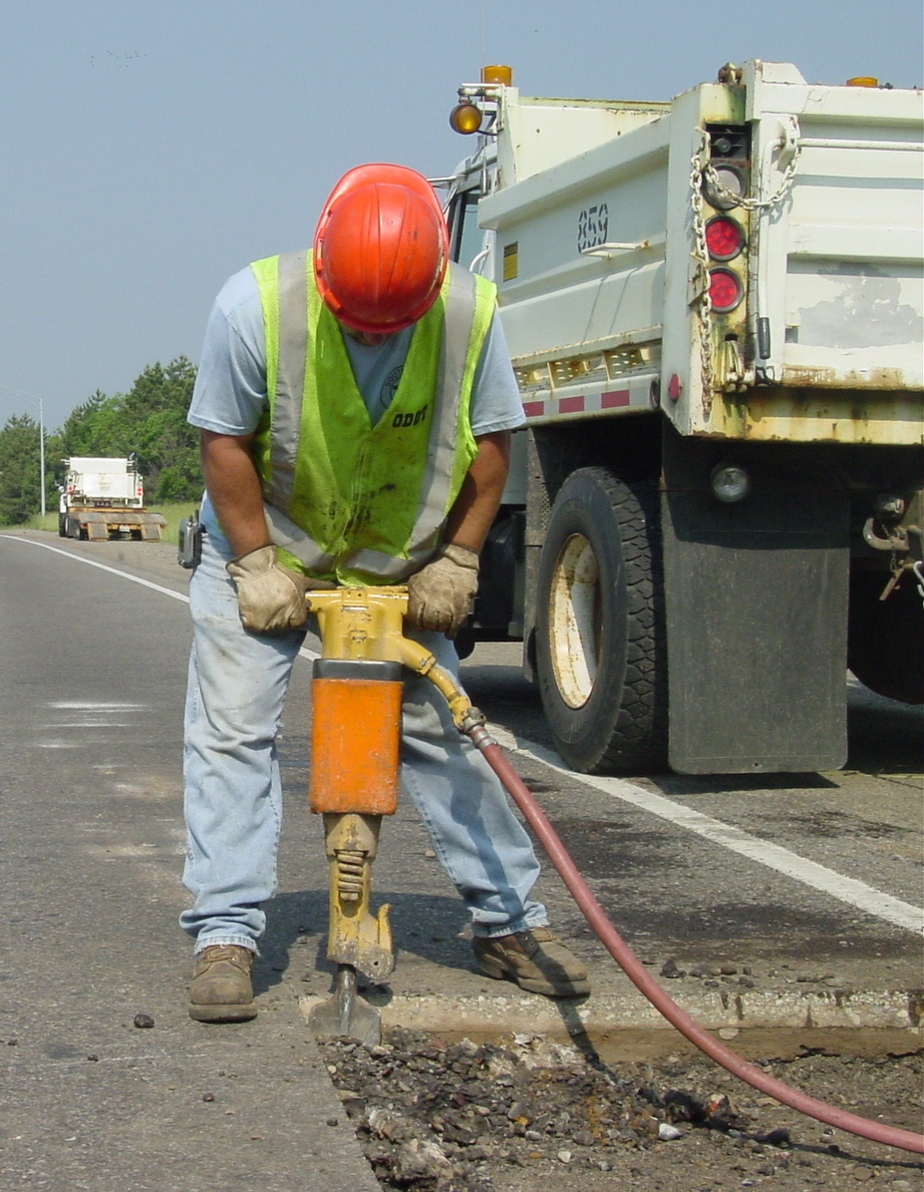
Pavement Breakers
Used in large scale demolition work, such as tearing down brick and concrete walls and breaking up concrete or pavement.
Usually weigh from 50 to 90 lbs

Slide 53
Hydraulic Jacks
Hydraulic tools when the application calls for extreme force to be applied in a controlled manner.
These tools do not operate at high speeds but great care should be used when operating them.
Hydraulic jacks have two basic parts: the pump and the cylinder.

