Slide 1
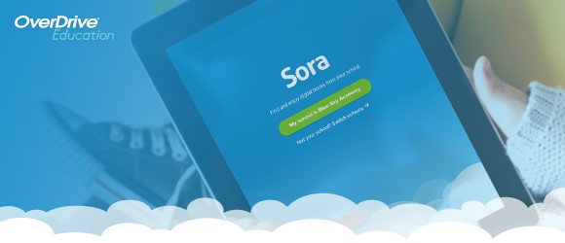
Using Sora (formally Overdrive) to Take Your Reading to The Clouds
The pathway for our students to read books on their electronic devices.
Presentation created by R. Pickard March 2014, adapted by W. Evans August 2020

Slide 2
Sora Introduction
Sora Digital Library and is available to all
Lee County Schools students and faculty.
Sora (formally Overdrive) is an internet-based “library” of ebooks that can be downloaded and read on all electronic devices from smartphones, iPads, Kindles, other eReaders, to laptop computers.
This library can be accessed 24/7…ANYWHERE, ANYTIME!!

Slide 3
Sora – How to Access
To access the Lee County Schools Sora/Overdrive
Library click on the Sora link on your desktop, Clever, or Download the Sora app on your personal device.
This will be where you log in to access Lee County
Schools’ eBook collection, download the apps {if they are
needed}, as well as checkout any eBook that is a available.
The following slides will show you how to log in and use the Lee County Schools Sora Library.
Your username and password are your usual Lee County username and password.

Slide 4
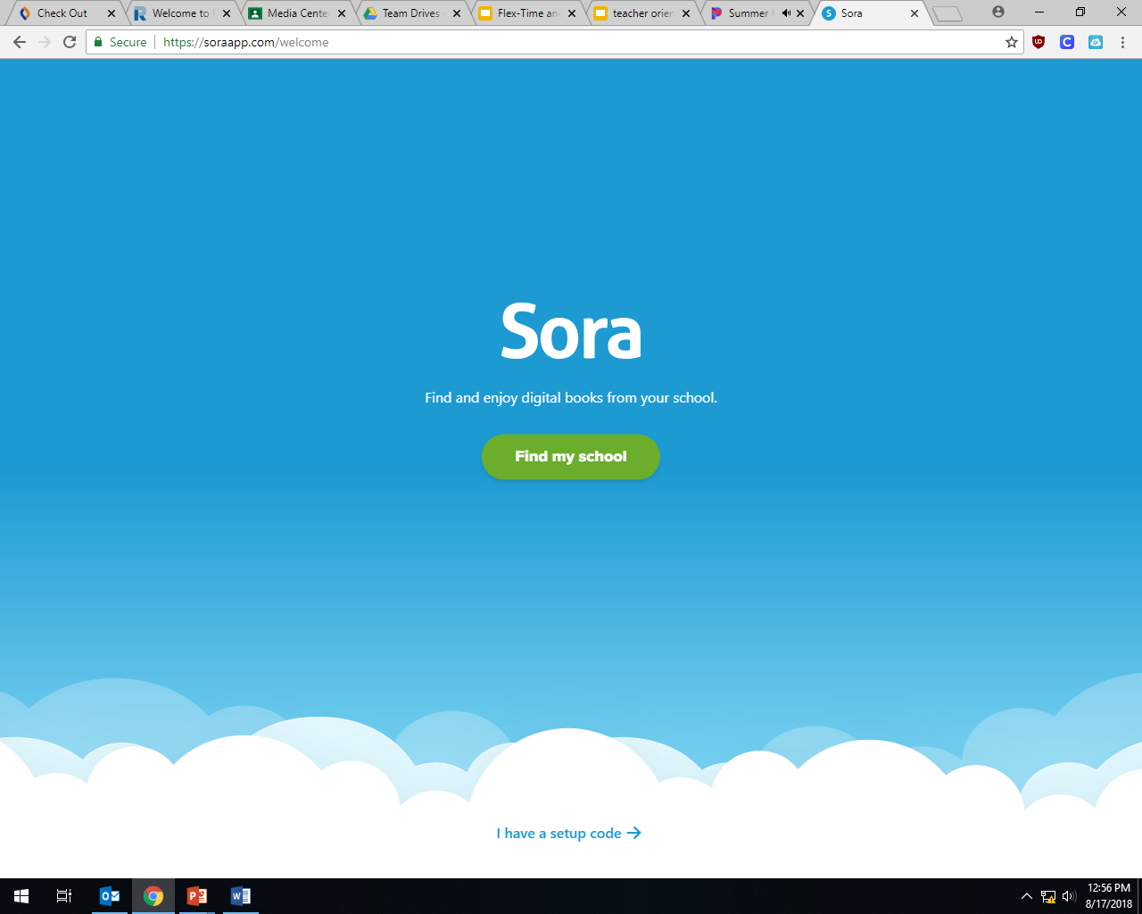
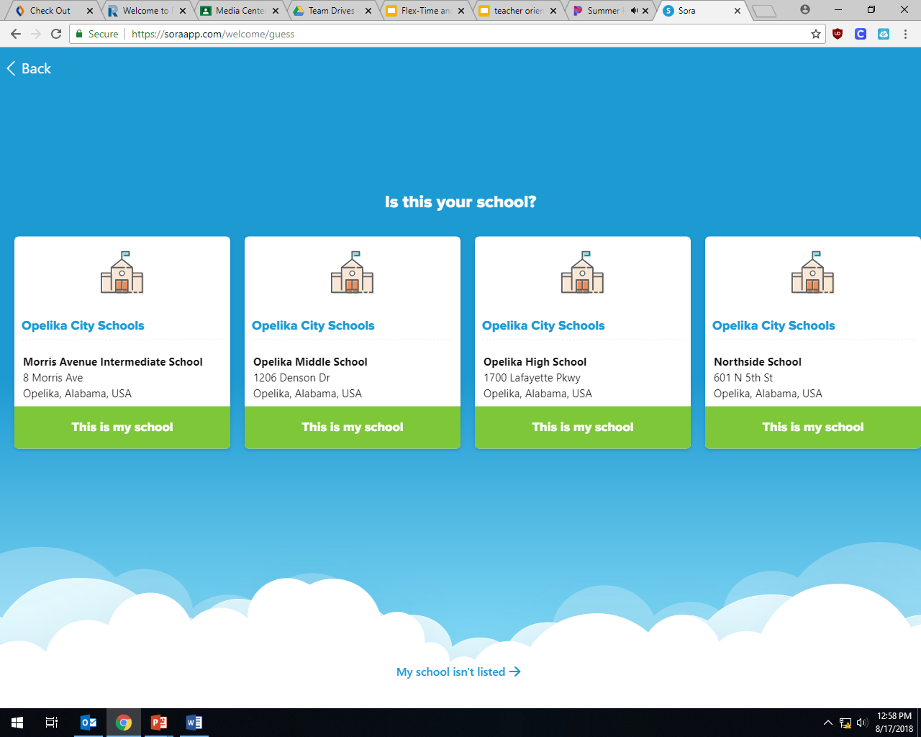
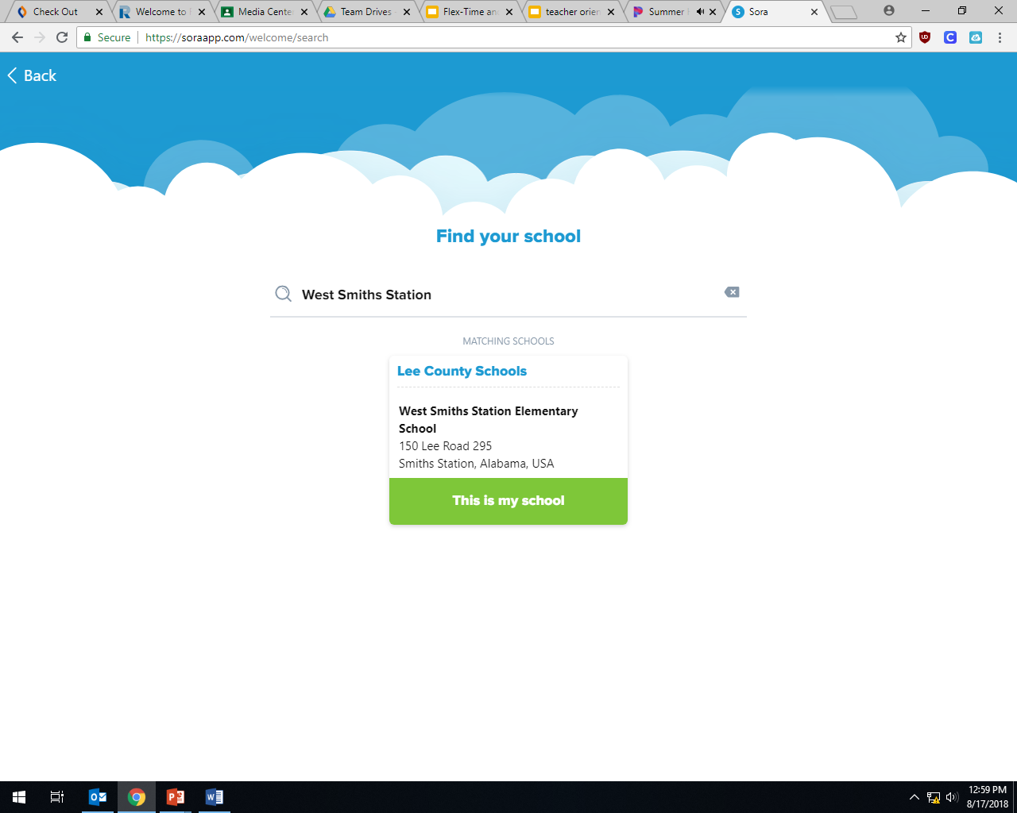
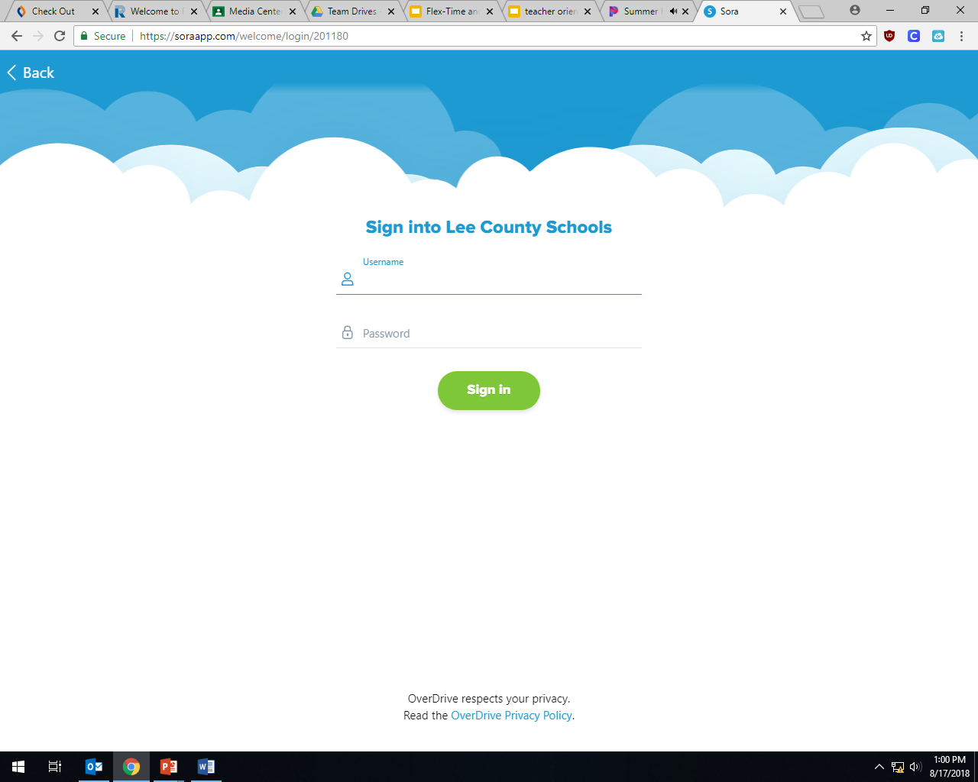
Sora – Sign-In Screen
The screen capture below is what you will see
when the Lee County Schools Sora Library web
has loaded..

Slide 5
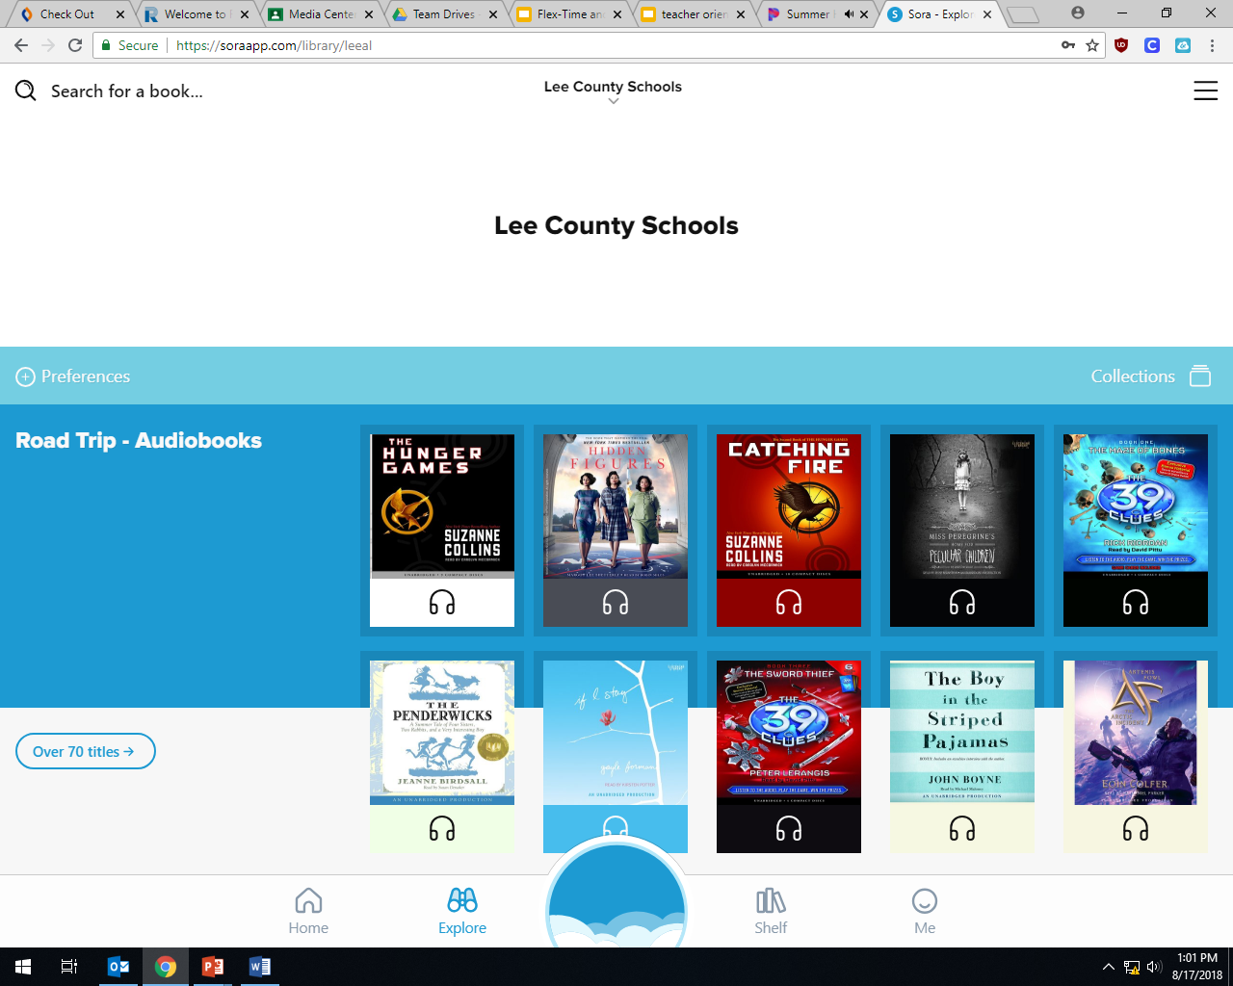
Sora – Home Page
With a successful login, a page like the one below
will load:
On this screen, you can see the newest additions, search the library for books, and get help if you need. To leave
the Lee County Schools Sora Library, simply log out.
Logout button can be found by clicking here.

Slide 6
Sora – eBook Availability
With the Lee County Sora Library, most eBooks are
just like print books in our Media Center. They can
only be checked by one student at a time.
If the eBook has been checked out, it will not be available until 14 days after it has been checked out, unless it is returned early. The eBook will automatically “return” to the Sora library after 14 days. If there is a hold on the eBook, it will be available to the first person who has a hold on it and then the next person as it goes down the “HOLD” line.
Project Gutenberg eBooks are excellent for those English and History research projects. They include many of the “classic” works of literature and history.

Slide 7
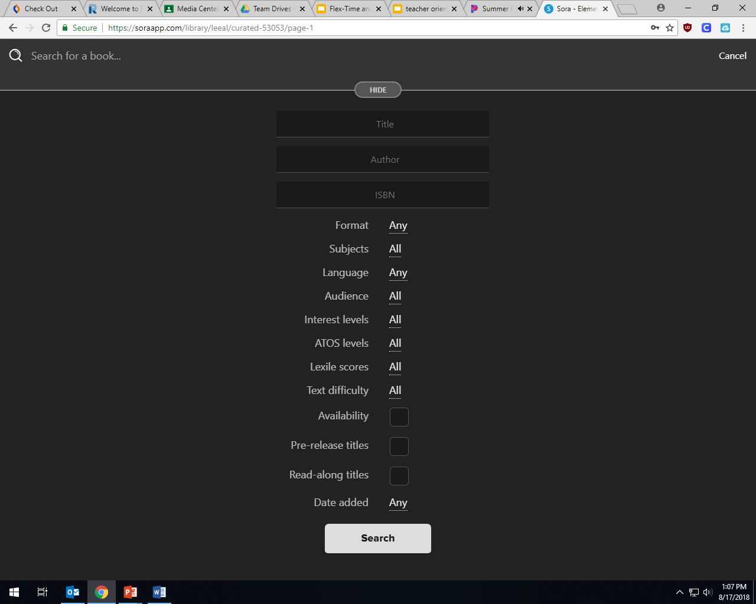
Sora – Search Page
The Lee County Sora Library can be
searched either by title or using an advanced search.
Click on the magnifying glass to search.
Elementary students will be limited to the elementary collection for checkout. Selecting an option under either Subjects or Collections when searching for an eBook, will open a webpage with a “bookshelf” full of eBooks that are examples of that option.

Slide 8
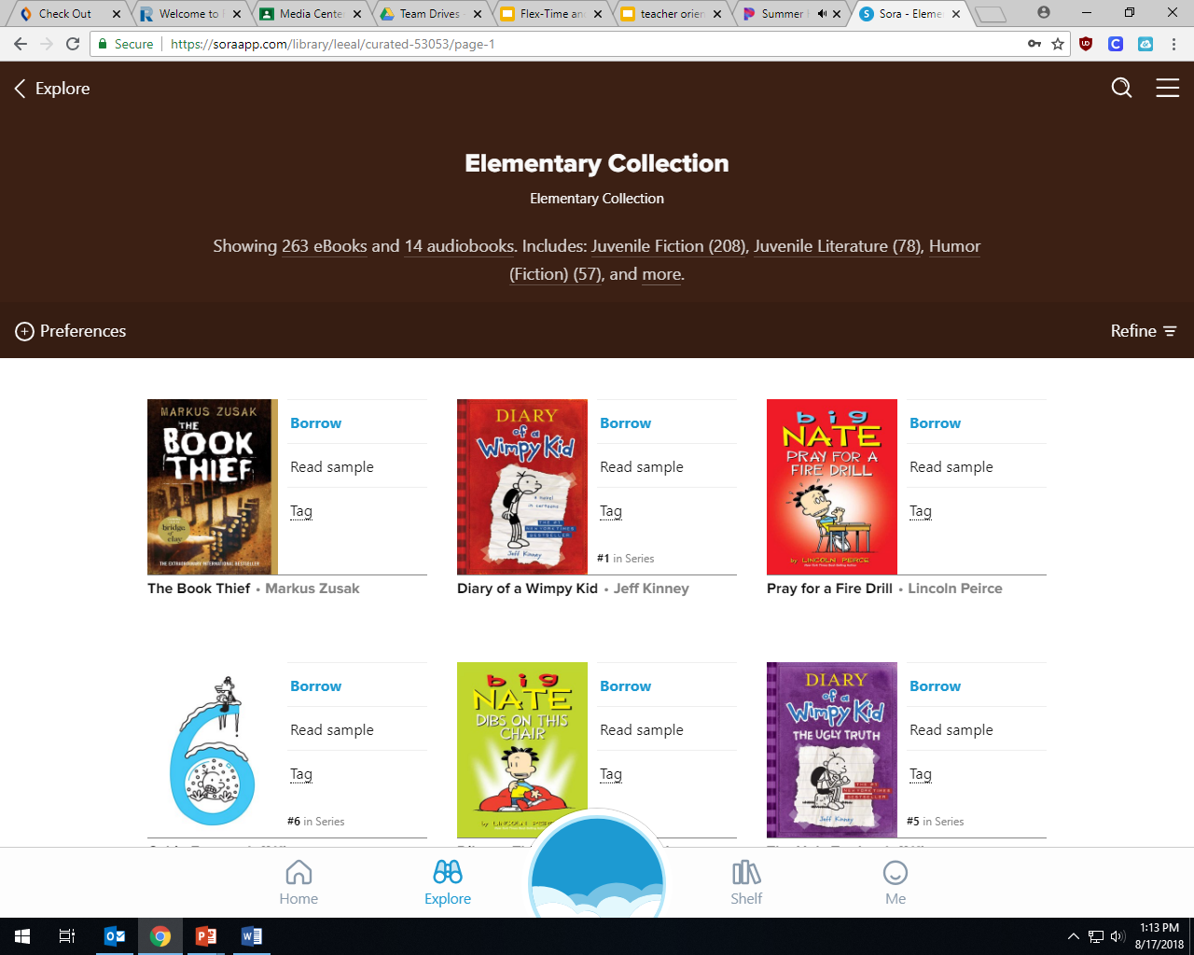
Sora – eBook Selection
Once the webpage with the bookshelf and eBooks
loads, to “borrow” an eBook you simply click on the word
Borrow
Click on borrow beside the book you want.

Slide 9
Sora – eBook Checkout
“Place a Hold” will put you in line to get the eBook when it becomes available. You will receive an email when the book becomes available.

Slide 10
Sora – eBook Checkout
If you have never downloaded an eBook to your device, you MAY need to do the one of the following:
{Your device will let you know}
Download the Sora App
(2) You may need to also download Adobe Digital Editions*
(3) You may also need to download Kindle Reader* {Available at amazon.com}
*Adobe and Kindle Apps will require you to set up a free account.
Use your student email for this: username@students.lee.k12.al.us

Slide 11
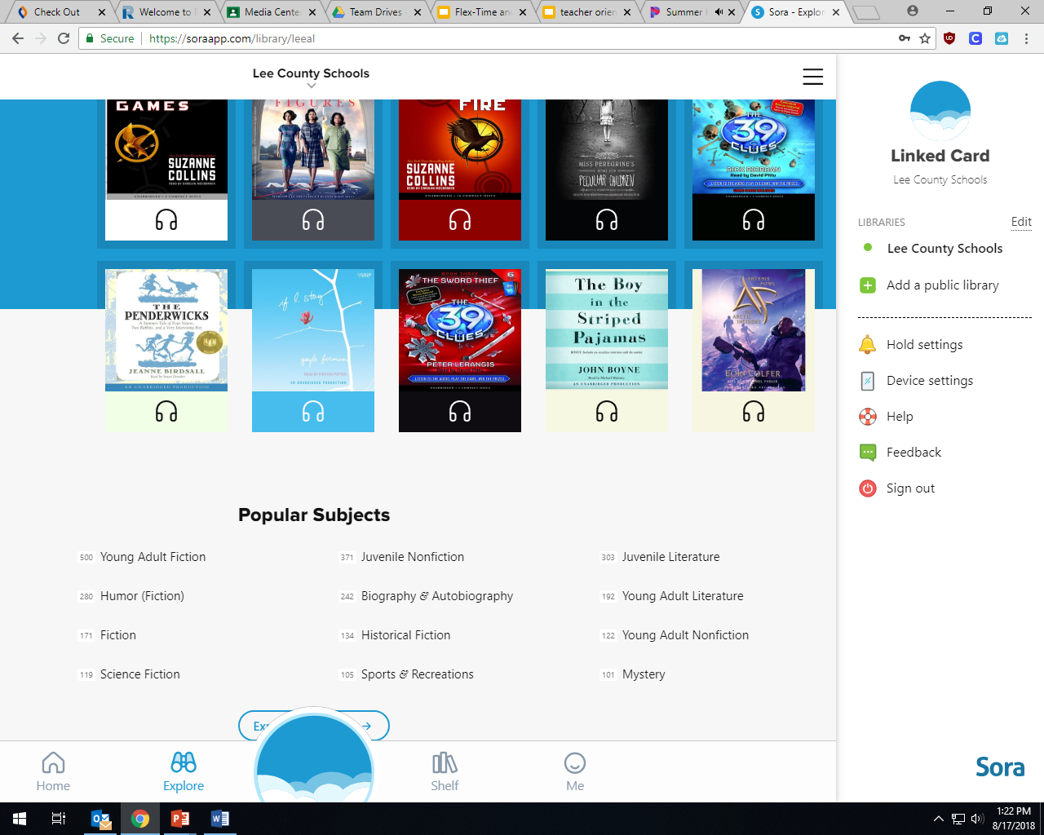
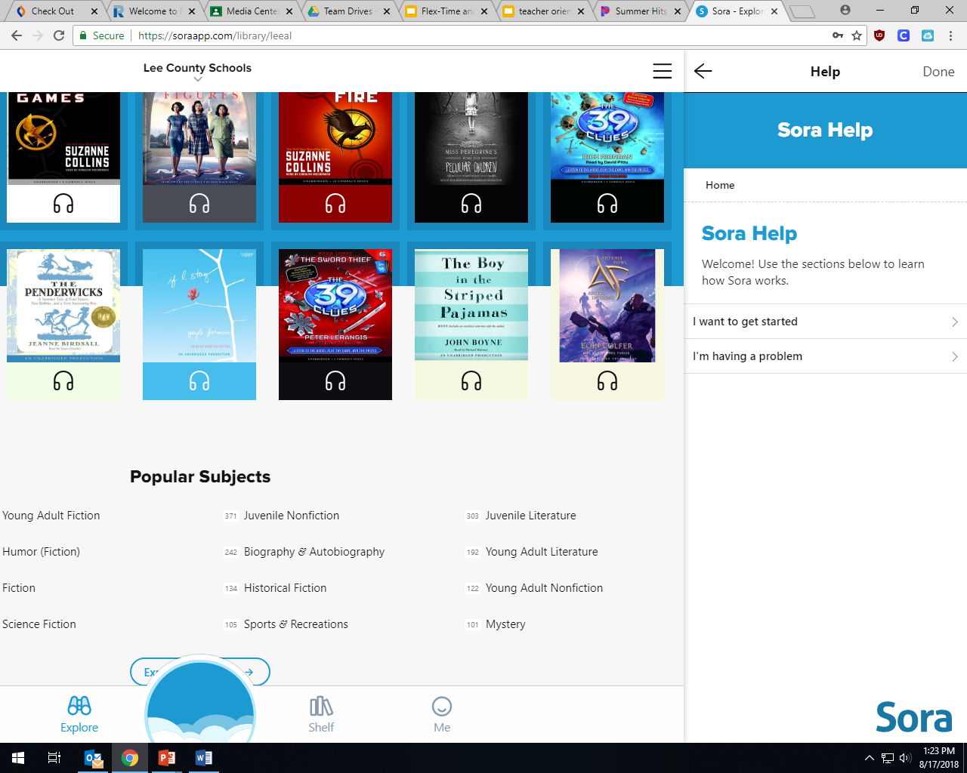
Sora – HELP
If you have any questions or need technical help
with the Lee County Schools Sora Library, click on
three lines in the top right corner of the webpage at the top to access the links to help.

Slide 12
Using Sora to Take Your Reading to The Clouds
West Smiths Station Elementary School Media Center
2020

